Slide 1
Workshop #4
Community Voices: Partnering for Accessibility and Inclusion in
Library Planning

Slide 2
Welcome!
Slide 1

Slide 3
Introductions
Slide 2

Slide 4
Learning Objectives
Understand why it is essential for libraries to partner with the community.
Develop a basic understanding of the community needs assessment and data collection.
Apply what you have learned to your library.
Identify strategies for collaborating with other libraries and organizations in your community to better support users with disabilities.
Slide 3

Slide 5
Agenda
Foundations
What is Library Outreach?
Barriers to Library Access
Common Successes and Barriers to Outreach
Planning a Community Needs Assessment
Activity #1
Community Partners
Relationship Building
Slide 4

Slide 6
Agenda - Continued
How to Analyze your Impact
Activity #2
Collecting the Data
Analyzing the Data
Activity #3
Evaluating your Outreach Effort
Activity #4
Recap
Closing
Slide 5

Slide 7
FOUNDATIONS
Slide 6

Slide 8
What is Library Outreach?
Slide 7

Slide 9
Discussion #1
What do you think of when you hear the term Library Outreach?
Slide 8

Slide 10
Library Outreach Definitions
Slide 9

Slide 11
Fanwood Memorial Library
The Monica Reiss Autism Resources Collection
Raise awareness of Autism
Provides library staff training
Employees people with disabilities
Slide 10

Slide 12
Taubman Health Sciences Library
University of Michigan
Investing Ability
Series of events about different topics related to disability.
Hosts every year.
Slide 11

Slide 13
Discussion #2
In what ways does your library reach out to the community with events for patrons with disabilities?
If your library does not currently have an established outreach program, what kinds of events or programs might you want to see implemented?
Slide 12

Slide 14
Project ENABLE - Challenge Video (#1)
Video: “The Challenge - Caroline Smith - Inclusive Outreach” (2:48)
Link to Challenge Video
Slide 13

Slide 15
Discussion (#3)
What would you do to solve this problem?
Slide 14

Slide 16
Project ENABLE - Solutions Video (#1)
Video: “A Solution - Caroline Smith - Inclusive Outreach” (9:54)
Link to Solutions Video
Slide 15

Slide 17
Barriers to Library Access
Slide 16

Slide 18
Quote From Annette DeFaveri
“For every person who finds the library safe and pleasant, there is another person who feels uncomfortable and unwelcome. … We librarians constantly strive to make our libraries an inclusive and welcoming place to all, but we are not always successful. There may be systemic barriers and elements of library policy that may prevent individuals or groups in our community from having full access to our library or from feeling safe and welcome at our library.”
Slide 17

Slide 19
Discussion (#4)
What do you think of this quote? Do you think that it is true of your library system?
Can you think of some examples that might be barriers to access in your library?
Slide 18

Slide 20
Library Fines
OVERDUE!
$$$$
Slide 19

Slide 21
Discussion (#5)
What is your library’s policy on fines?
Are there any alternatives you can think of?
Slide 20

Slide 22
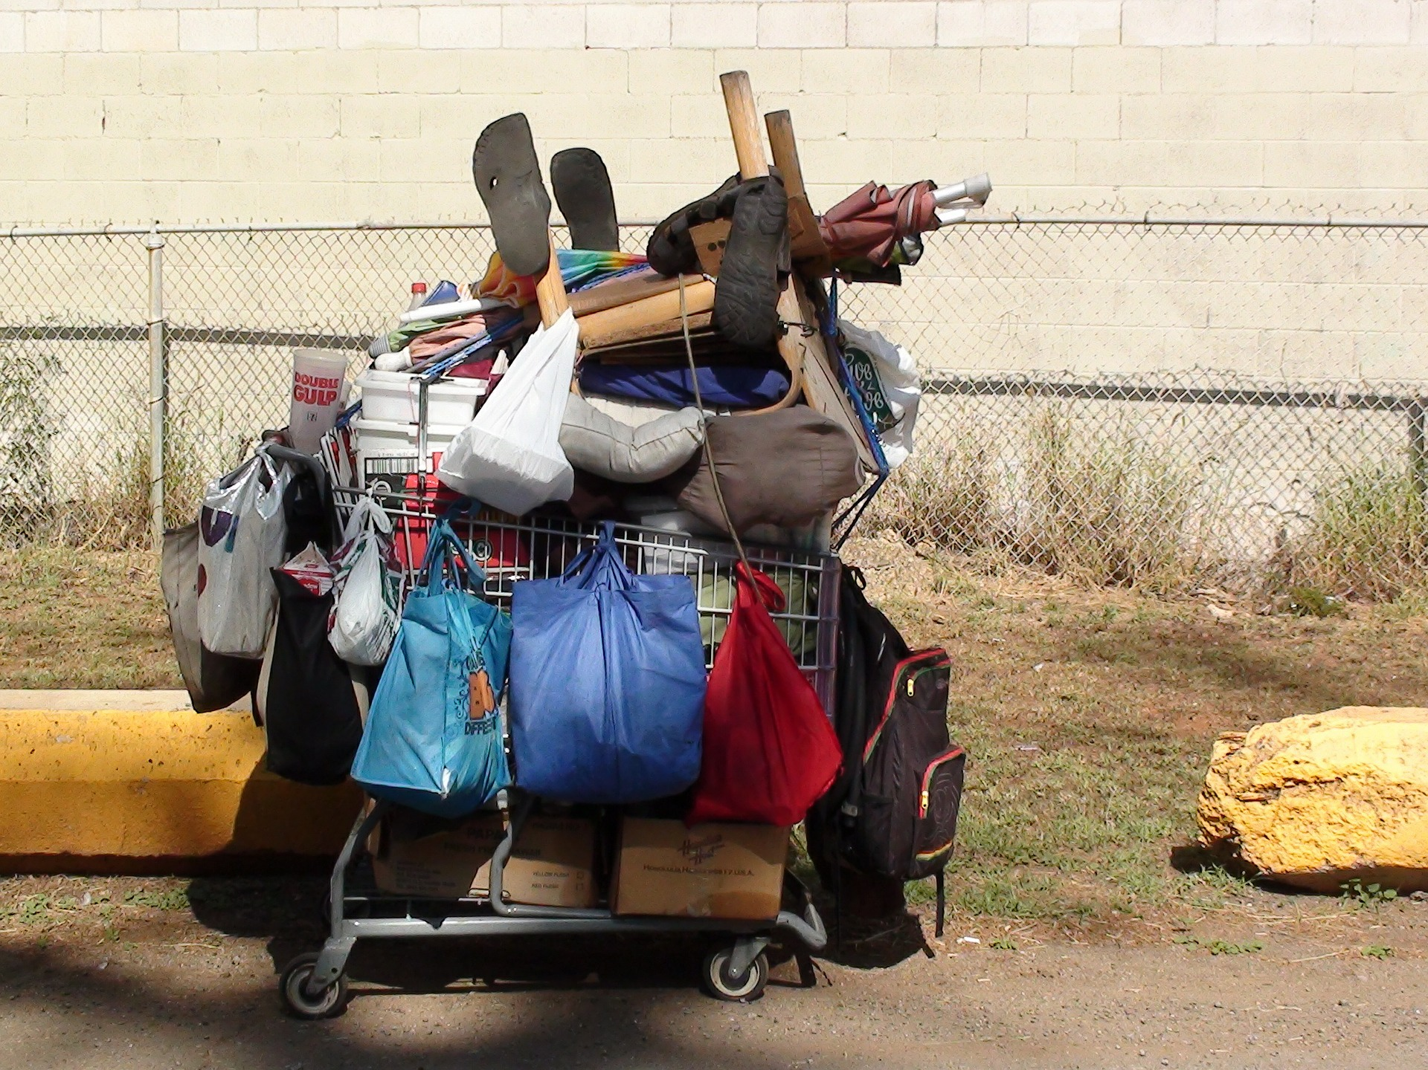
Backpacks
40% of people who are homeless have a disability, according to Disability Scoop.
Slide 21

Slide 23
Discussion (#6)
What is your library’s backpack policy?
Slide 22

Slide 24
Project ENABLE - Challenge Video (#2)
Video: The Challenge - Charlotte Moman - Lack of Training” (3:49)
Link to Challenge Video
Slide 23

Slide 25
Discussion (#7)
What would you do to solve this problem?
Slide 24

Slide 26
Project ENABLE - Solutions Video (#2)
Video: A Solution - Charlotte Moman - Lack of Training” (8:36)
Link to Solutions Video
Slide 25

Slide 27
Common Successes
and
Barriers to Outreach
Slide 26

Slide 28
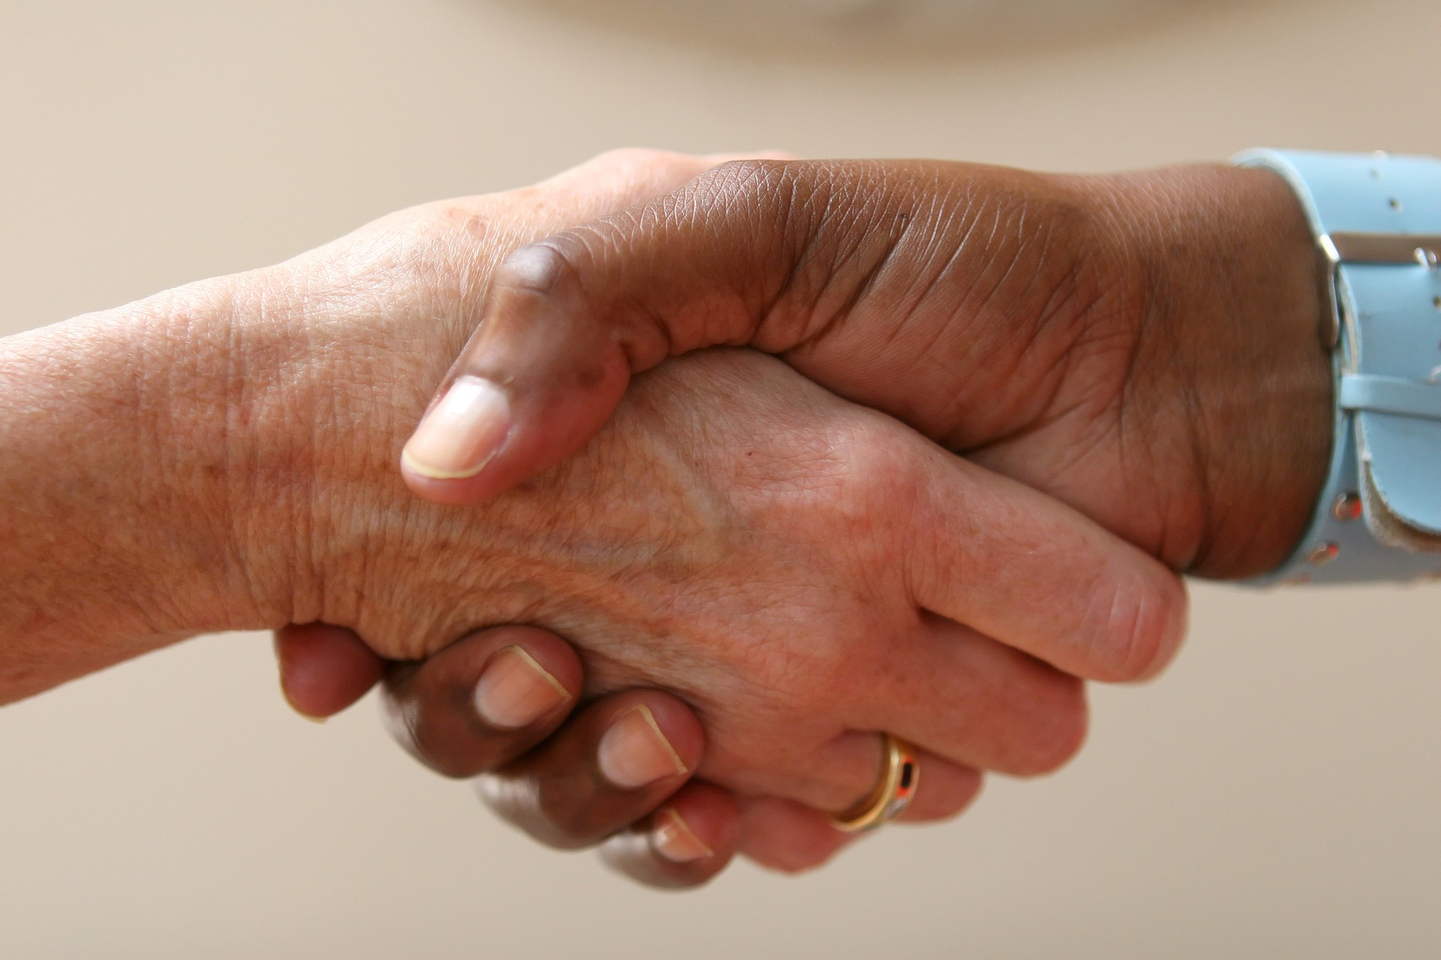
Long-Term Goals
Building trust is key.
You want to work with an organization, not just for your library.
Slide 27

Slide 29
Discussion (#8)
Write down what could be (or is) a long-term goal for working with a partner.
Slide 28

Slide 30
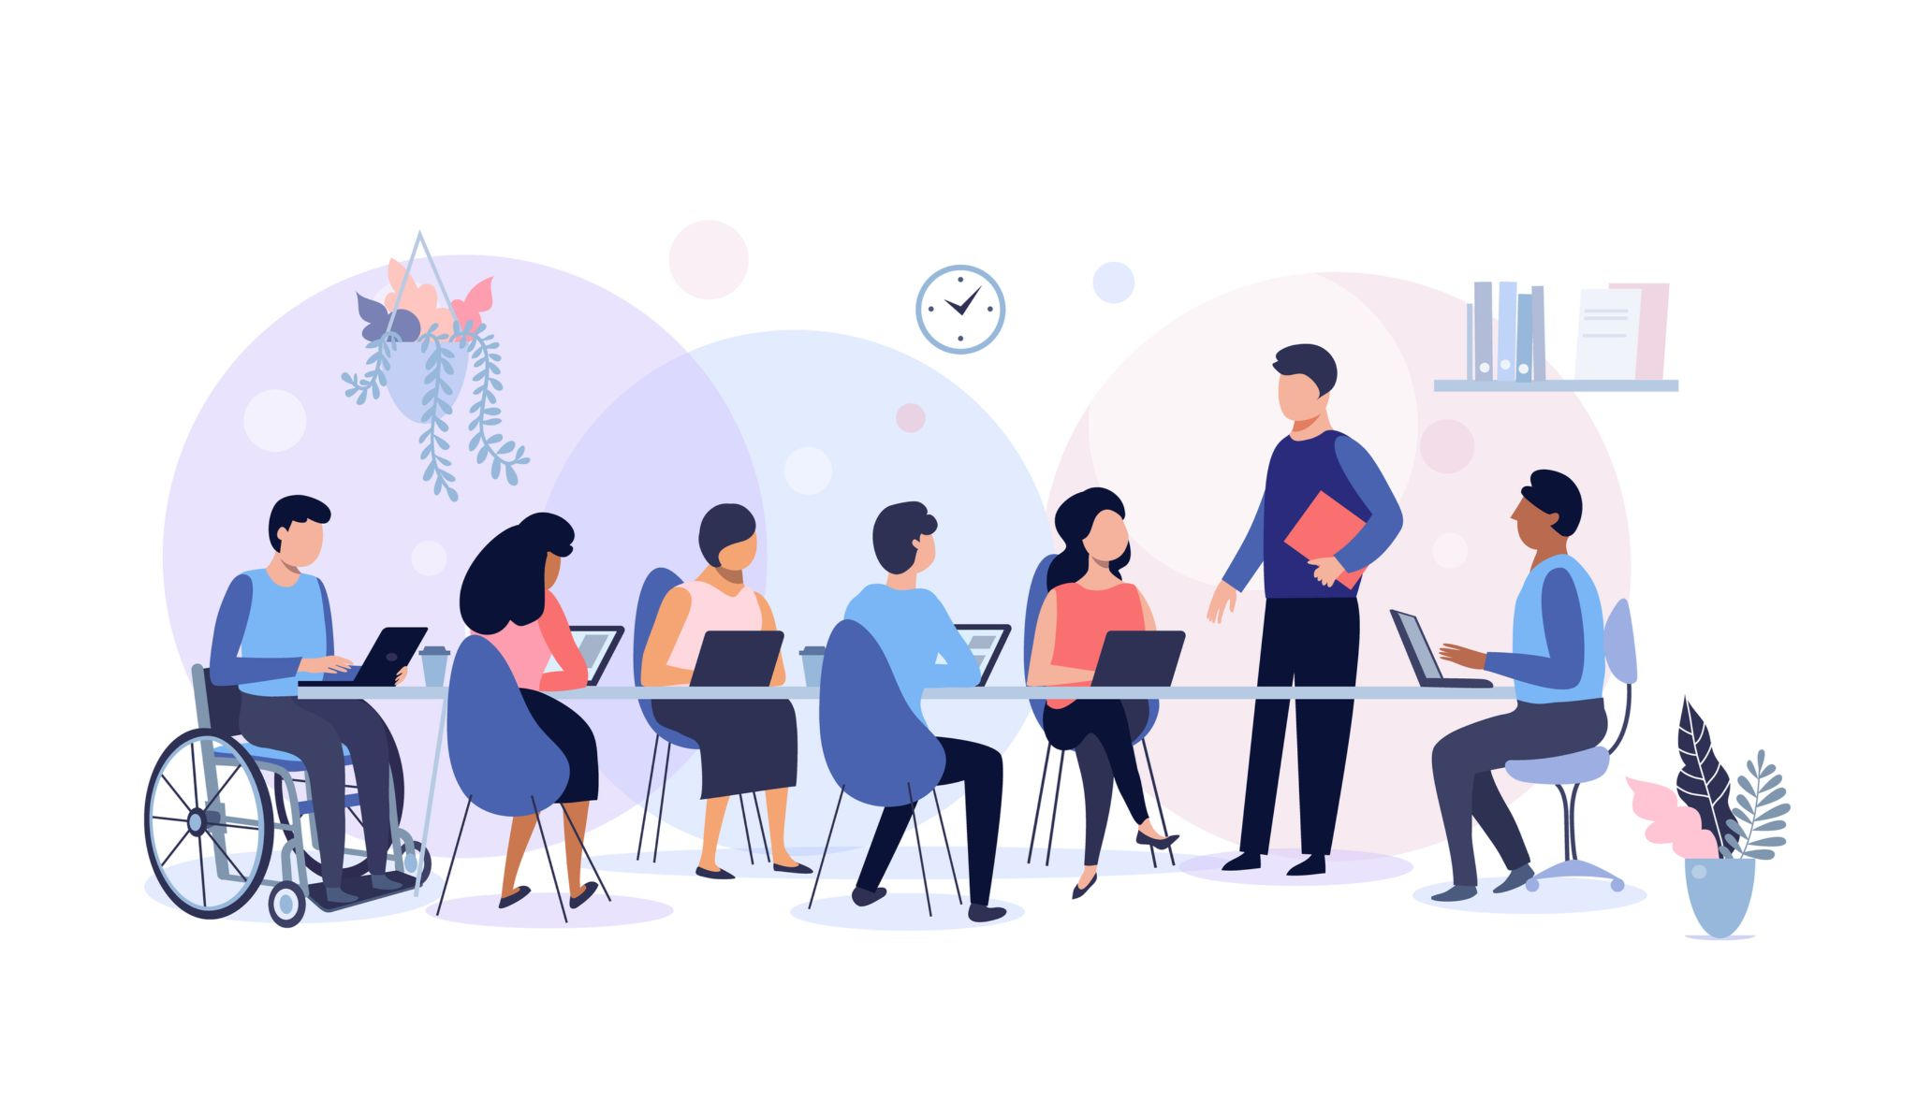
Co-Planning
Trust
Respect
Confidence
Slide 29

Slide 31
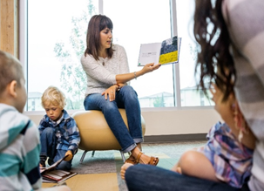
Impact
Attendance
Enthusiasm
Good reviews
Slide 30

Slide 32
Discussion (#9)
What are some ways patrons with disabilities might show interest in such a program?
Slide 31

Slide 33
What to Avoid During Library Outreach Programs
Lack of staff buy-in.
Similar project already in affect in your community.
Language Barrier (no ASL interpreters or closed caption for videos).
Slide 32

Slide 34
Project ENABLE - Challenge Video (#3)
Video: The Challenge - Tina Dolcetti - Low Cost UDL Sources” (2:36)
Link to Challenge Video
Slide 33

Slide 35
Discussion (#10)
What would you do to solve this problem?
Slide 34

Slide 36
Project ENABLE - Solutions Video (#3)
Video: A Solution - Tina Dolcetti - Low Cost UDL Sources” (6:02)
Link to Solutions Video
Slide 35

Slide 37
Planning a Community
Needs Assessment
Slide 36

Slide 38
Discussion (#12)
What could happen if you plan a new program without input from the community of potential participants?
Slide 37

Slide 39
Questions to Answer Before Creating a Survey - Part 1
What are your reasons for choosing to do this survey?
What are your goals in doing this survey?
Are you ready to conduct this survey?
How much time do you have to plan and conduct the survey, from start to finish?
Slide 38

Slide 40
Questions to Answer Before Creating a Survey - Part 2
How many people are going to be asked to participate?
What kinds of people will be asked to participate?
Are there any local disability organizations that might co-sponsor or provide input for your survey?
Are there any local disability advocates who might provide you with feedback on your survey before implementing it?
Slide 39
Slide 3

Slide 41
Discussion (#13)
What else can you think of to be investigated or planned before conducting a community needs assessment survey?
Slide 40

Slide 42
Survey Questions - Part 1
Do you have a current library card?
How often do you use/go to the library?
Why do you use the library?
What materials do you think should be emphasized at your library?
Of the following assistive technologies at the library, which have you used?
Slide 41

Slide 43
Survey Questions - Part 2
Are there any assistive technologies that you think your library should have?
What services have you used at your library?
What events have you gone to at your library?
What services would you like to see at your library?
What events would you like to see at your library?
Slide 42

Slide 44
Discussion (#13)
Take a few minutes and brainstorm 3-5 more questions to ask on a survey.
What did you come up with?
Slide 43

Slide 45
Community OIOCs
OIOCs: Overarching Institutions, Organizations, and Communities.
Local examples:
Disability education teachers
Mental health departments
Homeless shelter
Veteran’s program
Disability services organizations
School district leaders
Senior citizens group
Slide 44

Slide 46
Discussion (#14)
Take a couple of minutes and list a few examples of OIOCs for your library.
What are some of your examples?
Slide 45

Slide 47
Community Stakeholders
Primary Stakeholders: Primary stakeholders are directly impacted by the actions you take.
Secondary Stakeholders: Secondary stakeholders are indirectly affected by the actions you take.
Key Stakeholders: Key stakeholders are directly involved in the action itself, an action that could not be possible without participation from those stakeholders.
Slide 46

Slide 48
Discussion (#15)
Identify 2-3 stakeholders from each category for your library.
Slide 47

Slide 49
Activity #1
Break into groups of about 5-7 people.
Everyone will be assigned a particular role to play.
A Community Services Librarian.
A Library Director.
A Library Aide.
1-2 representatives from relevant community disabilities organizations (e.g., group serving the blind, autism support group, wounded veterans group).
The instructor will handout Activity Worksheet #1 which will explain more.
Regroup after 20 minutes and have a presenter ready to discuss what happened in the role play.
Slide 48

Slide 50
Role play Debriefing
What do you think was the most important outcome of this roleplay?
In your role-play session, what, if anything, should have been asked or included that wasn’t?
What did you learn from this activity?
Slide 49

Slide 51
Community Partners
Slide 50

Slide 52
National Disability Organizations
ADA National Network.
American Association of People with Disabilities.
National Organization on Disability.
Different & Able.
National Center for Learning Disabilities.
Alzheimer’s Association.
Cerebral Palsy Group.
Epilepsy Foundation.
Tourette Association of America.
Targeting Autism.
Slide 51

Slide 53
Local Disability Organization Examples
Disability education teachers.
School for people with disabilities.
Mental health centers.
Homeless Shelters.
Veterans Program.
Disability Services.
Social Services.
Slide 52

Slide 54
Disability Awareness Training
Project ENABLE.
Libraries and Autism: We’re Connected.
Project PALS (Panhandle Autism Library Service).
SNAILS (Special Needs and Inclusive Library Services).
Slide 53

Slide 55
Questions to Answer Before you Start
What are the disability organizations in your community?
Who are the individuals with disabilities in your community that you can partner with?
Who are the organization/individual and their goals/mission/vision?
What objective/goal your library wants out of the partnership (outcomes)?
Describe potential barriers to creating a partnership?
What financial resources (if any) can you allocate to this?
Who on your library staff will be working on this outreach program?
Slide 54

Slide 56
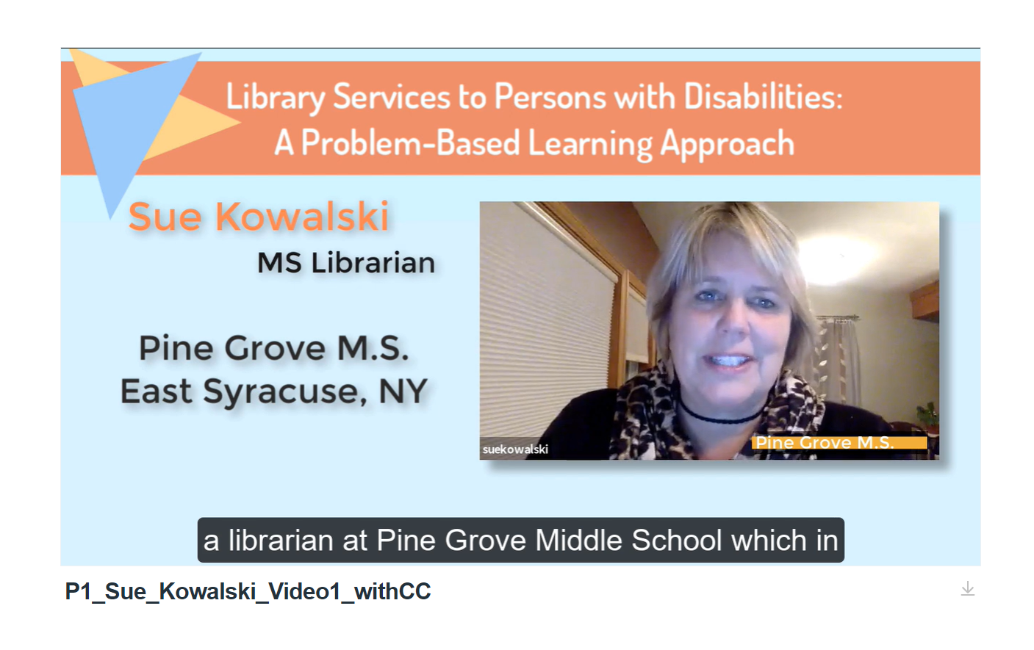
Project ENABLE - Challenge Video (#4)
Video: The Challenge - Sue Kowalski - Giving a Voice” (2:54)
Link to Challenge Video
Slide 55

Slide 57
Discussion (#16)
What would you do to solve this problem?
Slide 56

Slide 58
Project ENABLE - Solutions Video (#4)
Video: A Solution - Sue Kowalski - Giving a Voice” (8:22)
Link to Solutions Video
Slide 57

Slide 59
Relationship Building
Slide 58

Slide 60
Relationship Building Tips
Be transparent.
Always ask if a partner prefers Person-first or Identity-first language.
Ask open-minded and neutral questions.
Set up limits and boundaries.
Slide 59

Slide 61
Examples of Relationship Building
Part 1
Confidence - Your confidence will build as you get to know your partner better.
Self-Awareness - Think before you speak. Ask yourself, “is this insensitive?” “Will this hurt someone?”
Listening - Acknowledge that your partner’s experience with the library is different from your own. Listen to their comments and don’t invalidate their lived experiences. Try to understand where their words are coming from.
Slide 60

Slide 62
Examples of Relationship Building
Part 2
Cultural Humility - Acknowledge that you are still learning and will make mistakes.
Be Proactive - Be sure to be actively involved in the relationship.
Community Interest - People may not be immediately interested in partnering with you, that’s okay.
Slide 61

Slide 63
Examples of Relationship Building
Part 3
Library Experience - Listen to what your partner says about their library experiences and make an effort to change.
Trust and Respect - By continually developing a relationship over time and showing tangible results, you can build trust and respect between your library and partner. Remember, it takes time.
Slide 62

Slide 64
Break
Slide 63

Slide 65
HOW TO ANALYZE IMPACT
Slide 64

Slide 66
Activity #2
Break into the same groups as activity #1.
Those who had roles before will continue in them.
A Community Services Librarian.
A Library Director.
A Library Aide.
1-2 representatives from relevant community disabilities organizations (e.g., group serving the blind, autism support group, wounded veterans group).
The instructor will handout Activity Worksheet #2 which will explain more.
Regroup after 20 minutes and have a presenter ready to discuss what happened in the role play.
Slide 65

Slide 67
Role Play Debriefing
What do you think was the most important outcome of this roleplay?
What are some things you observed about each of the players?
What, if anything, should have been asked or included that wasn’t?
What did you learn from this activity?
Slide 66

Slide 68
Collecting the Data
Slide 67

Slide 69
Survey Distribution Methods
At the library - Easy to collect and free.
Online - Surveys can be distributed by email and take place on survey websites like SurveyMonkey.
Mailed - Print out and sent to representatives of your stakeholder groups. More costly due to paper, envelopes, and stamps.
Telephone - Can reach more people but can be very time-consuming, and there is always a risk of the recipient not answering or is busy.
In-person/face-to-face. This is highly time-consuming, but it might be the most productive if your library is in a relatively small community.
Slide 68

Slide 70
Discussion #17
Has your library ever distributed a community survey before? Please share with the group.
Who was the target audience?
What went as planned and what was challenging?
Slide 69

Slide 71
Survey Creation Tips - Part 1
Use short questions when possible.
Avoid leading questions and ambiguous questions.
Use clear instructions for the user.
Use either Calibri or Arial for the font, size twelve.
Use double space so that the survey is readable.
Slide 70

Slide 72
Survey Creation Tips - Part 2
Use black and white, no color.
Don’t use “double-barreled” questions.
Avoid asking patrons to rank questions.
Include some open-ended questions.
Include page numbers.
Include a closing statement thanking the patron for their time.
Also include the library’s contact information.
Slide 71

Slide 73
Other Data Collection Methods
Interviews - Usually one-on-one. A casual conversation between the librarian and patron with disabilities. You can have these in person or via a method like Zoom or Skype. Be sure to have your questions written down beforehand.
Focus Groups - A casual conversation between the librarian and 4-5 patrons with disabilities.
Observations - The librarian observes the patron with a disability in the library.
Slide 72

Slide 74
Survey Protocol
Pilot testing.
Participants must volunteer for the survey.
Get verbal and written confirmation of participation.
Use coding or pseudonyms for participant’s annonominity.
If a person doesn't want to participate, that’s okay. Don’t force it.
Slide 73

Slide 75
Discussion #18
Have you ever participated in one of the listed methods (Survey, Interview, focus groups, or observation) of data collection?
How was your experience?
What changes would you make to the process?
Slide 74

Slide 76
Analyzing the Data
Slide 75

Slide 77
Questions for Analyzing Data
What do we want to do with the information collected?
For whom is this information intended?
Do any common trends appear?
What is working (and what isn’t)?
Slide 76

Slide 78
Visualizing your Data
Bar Charts - Number values are represented by either height or length in a graph.
Data Points - Single measurement in a set of numbers.
Pareto Chart - Bar chart where the bars are sorted by size order with the highest bar on the left of the graph.
Pie Chart - Way of showing shares.
Radar Chart - Demonstrates the size among gaps.
Run Chart - Displays variation of data over time.
Scatter Chart - Show the influence one variable has on the data set as a whole.
Slide 77

Slide 79
Discussion #19
Which tools have you used before?
What ones do you think would be best for your library’s community needs assessment?
Slide 78

Slide 80
Activity #3
Break into small (3-5 people) discussion groups.
Complete activity worksheet #3. It contains a description of the situation and the information needed by the librarian (who is leading the meeting).
Regroup after 20 minutes and have a presenter ready to share your work with the group.
Slide 79

Slide 81
Evaluating you Outreach Effort
Slide 80

Slide 82
Qualitative and Quantitative
Quantitative Measurements: (typically numerical) collect data that can be measured.
Qualitative Measurements: (typically stated verbally) collect the experience of a person .
Slide 81

Slide 83
Discussion #20
Qualitative measurements are also known as anecdotal evidence. Tell us of an experience you had where a patron gave you their experience of an event at the library. It can be a positive or negative experience.
Slide 82

Slide 84
Methods of Collecting Impact Data
Observation
Focus Groups
Interviews
Questionnaire
Slide 83

Slide 85
Activity #4
Break into small (4-5 person) discussion groups.
Create a 5 question survey based on the scenario given on your Activity Worksheet #4.
Regroup after 10 minutes and have a presenter ready to share your work with the group.
Slide 84

Slide 86
Recap
Library outreach takes time and effort in order to have lasting effects on your library and community.
There are multiple barriers that would prevent someone from feeling unwelcome at the library. It is our job to remove them.
You need to consider what might prevent you from conducting outreach before planning.
It is essential to conduct a community needs assessment first.
Partner with your local community organizations.
Building relationships with your local community organizations takes time and effort.
There are multiple ways to collect the data you need for your community needs assessment.
To analyze data is an essential way to provide evidence that there is a need in your community for your program or service.
Evaluation of outreach programs and services essential to demonstrate the impact of your program and to get funding.
Slide 85

Slide 87
Closing
Complete the workshop evaluation.
Submit it to the instructor.
Take what you have learned and apply at least one new idea to your library.
Enjoy your day!
Slide 86

Slide 88
Thank you!
Slide 87

