Slide 1
Workshop 3:
Universal Design for Learning in Libraries

Slide 2
Welcome!
Slide 1

Slide 3
Introductions
Slide 2

Slide 4
Learning Objectives
Understand the concept of Universal Design for Learning (UDL) and its principles in the context of your library’s instructional programs.
Apply UDL to programs in your library.
Develop a basic understanding of the ARCS Model and how it complements UDL.
Identify your library programs that require UDL principles.
Slide 3

Slide 5
Agenda
Foundations
Universal Design (UD)
Universal Design for Learning (UDL)
Activity #1
History of UDL
Library Programs and Learning Preferences
Slide 4

Slide 6
Agenda - Continued
Applications of UDL
UDL and Online Library Programs
Activity #2
Program Development and UDL
The ARCS Model
Activity #3
Recap
Closing
Slide 5

Slide 7
Why?
Slide 6

Slide 8
Foundations
Slide 7

Slide 9
Universal Design
Slide 8

Slide 10
Discussion (#1)
What do you think of when you hear the term Universal Design?
Slide 9

Slide 11
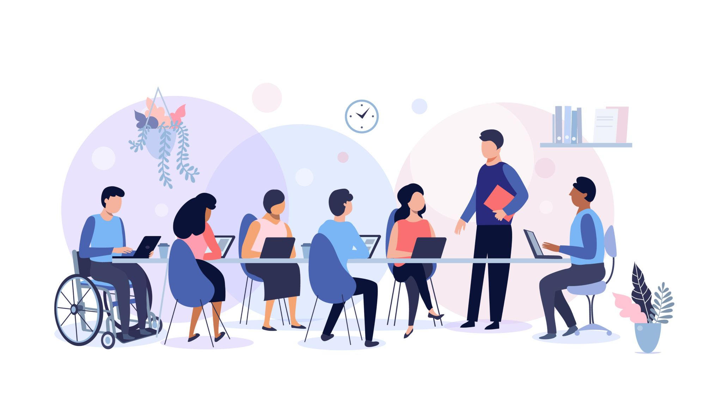
What is Universal Design?
Universal Design is a space (physical or digital) that everyone can
easily access and navigate.
Slide 10

Slide 12
Library Examples of Universal Design
Tilting the bottom shelves up so that patrons don’t have to kneel or crouch down to the floor to retrieve objects;
Providing patrons with multiple formats of the same material (audiobooks, books, graphic novels, movies, etc.);
Service desks should be low enough to allow a patron using a wheelchair to reach the counter.
Slide 11

Slide 13
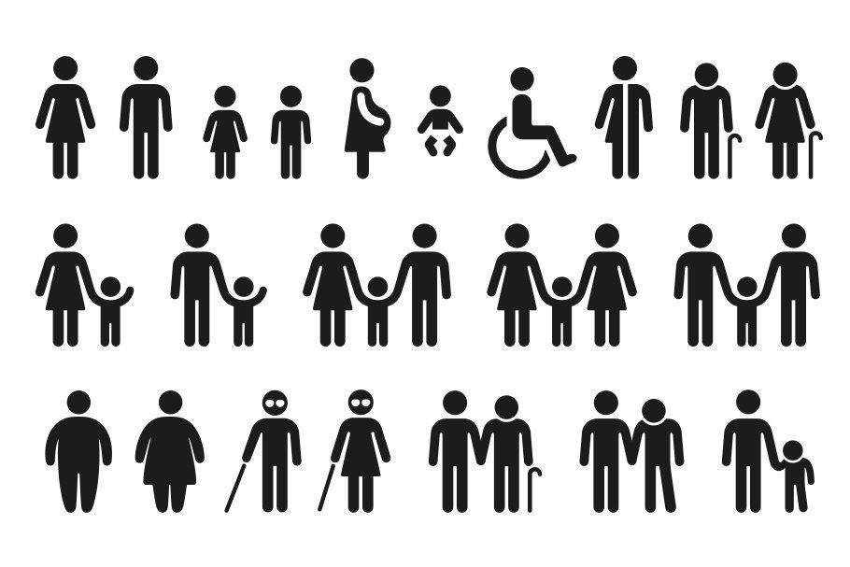
7 Principles of Universal Design
Equitable Use
Flexibility in Use
Simple and Intuitive Use
Perceptible Information
Tolerance for Error
Low Physical Effort
Size and Space for Approach and Use
Slide 12

Slide 14
Definitions of the 7 Principles
Equitable Use- The design is useful and marketable to people with diverse abilities.
Flexibility in Use - The design accommodates a wide range of individual preferences and abilities.
Simple and Intuitive Use - The design is easy to understand, regardless of the user's experience, knowledge, language skills, or current concentration level.
Slide 13

Slide 15
Definitions of the 7 Principles Cont.
Perceptible Information - The design communicates necessary information effectively to the user, regardless of ambient conditions or sensory abilities.
Tolerance for Error - The design minimizes hazards and the adverse consequences of accidental or unintended actions.
Slide 14

Slide 16
7 Principles - Cont.
Low Physical Effort - The design can be used efficiently and comfortably with a minimum of fatigue.
Size and Space for Approach and Use - Appropriate size and space are provided for approach, reach, manipulation, and use regardless of the user's body size, posture, or mobility.
Slide 15

Slide 17
UD Library Examples
Provide various materials such as audiobooks, articles, books, websites, and videos on a particular topic.
Provide various types and arrangements of seating options.
Use signage that has wording, quickly recognizable symbols, and braille. One popular example is the directional sign for stairs. Usually, there is the word ‘stairs’ in English underneath a simple flight of stairs.
Slide 16

Slide 18
UD Library Examples Continued
At the entrances to the library, have a space that communicates the library layout along with “you are here” locators. This is also helpful in the stacks, particularly for libraries with multiple floors and multiple sections on each floor.
Consider the placement of power outlets. Avoid power outlets that stick up in the middle of the floor and power outlets behind the bottom bookshelf. Patrons require more access to power outlets and need easy and quick access.
Shelving takes up a lot of space, and it is hard to navigate around for patrons in a wheelchair. Providing online content such as eBooks and audiobooks allows for more open space at your library.
Allow for the patron to create their workspace. Height-adjustable desks also provide a good example of accessible furniture. Be sure to design workspaces with enough space so that patrons with mobility issues can easily navigate through the space.
Slide 17

Slide 19
Project ENABLE - Challenge Video (#1)
Video: “The Challenge - Holly Jin - Physical Barriers” (3:20) -
Link to Challenge Video
Slide 18

Slide 20
Discussion (#2)
What would you do to solve this problem?
Slide 19

Slide 21
Project ENABLE - Solutions Video (#1)
Video: “The Solution - Holly Jin - Physical Barriers.” (7:24) -
Link to Solutions Video
Slide 20

Slide 22
Universal Design for Learning
Slide 21

Slide 23
Center for Applied Special Technology (CAST)
Engagement - Offer patrons different ways to interact with your content that interests and engage them.
Representation - Present your information in different ways throughout the library program. Don’t just choose one method. Variety adds to interest and engagement, particularly the use of interactive methods of presenting the information.
Action and Expression - Provide different ways to allow the patrons to demonstrate what they’ve learned.
Slide 22

Slide 24
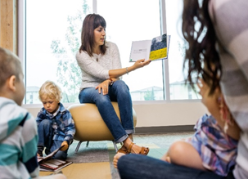
Engagement
Roleplay
Activities
Group discussions
Slide 23

Slide 25
Representation
Lectures
Discussions
Videos
Debates
Computer-based presentations
Slide 24

Slide 26
Action and Expression
Written evidence of learning
Questioning (encourage patrons to ask questions)
Media-based or technology-based evidence of learning (vidoes, interactive learning games like Kahoot)
Slide 25

Slide 27
Diving Deeper into UDL Principles
Each of the UDL principles is further specified by a number of guidelines, with checkpoints that expand upon the guidelines.
Provide options for perception:
Provide captions or transcript for a video.
Present text in larger font sizes.
Provide tactile alternatives for visual displays.
Slide 26

Slide 28
Each Patron’s Needs are Different
Patrons with mobility issues might not be able to participate in certain activities.
Patrons who have a hard time sitting still need to move and get up during the program.
Patrons who have learning disabilities each have different approaches to how they receive and process information.
Slide 27

Slide 29
Library UDL Examples
Providing e-books in multiple formats.
Providing instructional materials in large, legible fonts.
Finding alternative materials for students with disabilities before beginning instruction or a library program.
Using different media and visual representations to explain a concept, including videos and infographics.
Downloading apps designed for students with disabilities.
Slide 28

Slide 30
Project ENABLE - Challenge Video (#2)
Video: The Challenge - Tina Dolcetti - Low Cost UDL Sources” (2:36)
Link to Challenge Video
Slide 29

Slide 31
Discussion (#3)
What would you do to solve this problem?
Slide 30

Slide 32
Project ENABLE - Solutions Video (#2)
Video: A Solution - Tina Dolcetti - Low Cost UDL Sources” (6:02)
Link to Solutions Video
Slide 31

Slide 33
Activity #1
Break into small (3-5 people) discussion groups. [You will be in the same groups for each activity].
You will be creating an introductory lesson for an Information Literacy Program using at least three examples of teaching/learning strategies based on UDL principles. You can choose between adults, teenagers, and children for the target audience. (We will build upon your work for this activity in the following activities).
Regroup after 20 minutes and have a presenter ready to share your work with the group.
Slide 32

Slide 34
History of UDL and the ADA
Slide 33

Slide 35
Creation of CAST and UDL
Anne Meyer, David Rose, Grace Meo, Skip Stahl, and Linda Mensing created the Center for Applied Technology (CAST) in 1984.
The founding members coined the term Universal Design for Learning.
Their original mission was to see if they could use computers to help users with learning disabilities. However, it snowballed into accessible education for all students.
Slide 34

Slide 36
Development of UDL
1985 - Developed a partnership with Apple which resulted in the text-to-speech program put onto their computers.
1988 - Equal Access program was developed, early stages of UDL.
1993 - WiggleWorks was co-developed with Scholastic and was the first early literacy software series with UDL features.
2008 - Universal Design of Learning Guidelines 1.0 was published.
Slide 35

Slide 37
Americans with Disabilities Act
The ADA prohibits discrimination against people with disabilities. People with disabilities are entitled to the same rights and opportunities as non-disabled people.
A vital concept is that covered entities must ensure that they use effective communication with individuals with disabilities that affect communication, such as hearing, vision, reading, learning, speech, intellectual, and sometimes mental health impairments.
Slide 36

Slide 38
ADA Library Examples
Tables at the library should have 27-inch high clearance and 19 inches of depth.
Space between furniture should be 40 inches.
The top row at the stacks shouldn’t be higher than 48 inches.
Aisles should have at least 36 inches of clearance, but 42 inches is preferred.
Service desks (reference, check out, etc.) shouldn’t be higher than 36 inches.
The floor should be smooth and bump-free.
Slide 37

Slide 39
ALA Policy
History of serving people with disabilities.
Library of Congress first services to people with disabilities was in 1897.
Standards regarding equal access were created in 1961.
Policy was updated in 2001.
Slide 38

Slide 40
Different Learning Preferences
Slide 39

Slide 41
7 Preferences of Learning
Visual - People who learn by seeing.
Aural - People who learn by listening.
Verbal - People who learn by speaking or repeating out loud.
Physical - People who learn by touching or doing.
Slide 40

Slide 42
7 Principles of Learning Cont.
Logical - People who learn by using numbers.
Social - People who learn better in groups of people.
Solitary - People who learn better by themselves.
Slide 41

Slide 43
How you teach depends on the content
Where is Chicago?
What does salt taste like?
Slide 42

Slide 44
Discussion #4
Can you give some examples of how your learning preference changes when learning different types of content?
Slide 43

Slide 45
How you Teach also Depends on
the Learner’s Ability
Visually Impaired
Deaf or Hard of Hearing
Autistic Patron
Slide 44

Slide 46
Break
Slide 45

Slide 47
Applications of UDL
Slide 46

Slide 48
UDL and Online Library
Instruction
Slide 47

Slide 49
Online Library UDL Examples
Allow the patron to choose whether they have their camera on or off. This will allow a patron who might not be comfortable showing themselves on camera to participate.
Create time for break-out rooms. Sometimes patrons feel more comfortable speaking in smaller groups. Talking in a group of 50 people on a platform like Zoom or Microsoft Teams is very different than the in-person experience or in a small online group.
Slide 48

Slide 50
Online Library UDL Examples Cont.
Allow the patrons to chat or talk to each other before and after the program. This will allow for a more personal connection with the other participants of the library program.
Send out a schedule and any resources via email ahead of time. This will allow the patron to prepare, understand the flow of the session, and sort out any potential or actual technology issues ahead of time.
Slide 49

Slide 51
Discussion #5
What library programs have you had to change or tweak to be able to transfer them online during the pandemic?
Slide 50

Slide 52
Questions Before Starting
How are you going to display information to patrons?
How are you going to keep track of time?
Do you need to use automatic captioning systems?
What technology are you using in the lesson?
Slide 51

Slide 53
Questions Before Starting Cont.
Is the technology that you are using accessible to different types of abilities?
If you are going to be using additional technology besides the video software (e.g. Kahoot) set aside time to show your patrons how to use it.
Schedule breaks if the program is over an hour (or as needed).
Anticipate questions that may arise and address them in advance of the program.
Slide 52

Slide 54
Activity #2
Break into the same groups from the first activity.
Expand your lesson as an online program, using at least three UDL examples related to online instruction.
Regroup after 20 minutes and have a presenter ready to share your work with the group.
Slide 53

Slide 55
Program Development
Slide 54

Slide 56
Project ENABLE - Challenge Video (#3)
Video: The Challenge - Renee Grassi - Creative Budgeting (3:00)
Link to Challenge Video
Slide 55

Slide 57
Discussion #6
What would you do to solve this problem?
Slide 56

Slide 58
Project ENABLE - Solution Video (#3)
Video: A Solution- Renee Grassi - Creative Budgeting (14:23)
Link to Solutions Video
Slide 57

Slide 59
Take & Make Kits
Choose a craft or theme that you can match with a book.
Prepare unassembled craft material.
Create an easy-to-follow set of instructions.
Put the materials in a bag for the patron to pick up.
Hold the program on your favorite video platform!
Slide 58

Slide 60
Project ENABLE - Challenge Video (#4)
Video: The Challenge - Caroline Smith - Inclusive Outreach (2:48)
Link to Challenge Video
Slide 59

Slide 61
Discussion #7
What would you do to solve this problem?
Slide 60

Slide 62
Project ENABLE - Solutions Video (#4)
Video A Solution - Caroline Smith - Inclusive Outreach (9:54)
Link to Solutions Video
Slide 61

Slide 63
The ARCS Model of
Motivational Design
Slide 62

Slide 64
4 Factors in the ARCS Model
Attention: Gain and maintain the patron’s attention throughout the library program.
Relevance: Make the program personally meaningful and important to the patron.
Confidence: Create a program in which the patron can feel they can succeed. (Neither too hard nor too easy)
Satisfaction: Learners feel they accomplished learning goals.
Slide 63

Slide 65
Discussion #8
What are some memorable things a teacher has done to get your class’s attention?
Slide 64

Slide 66
Attention!
Be enthusiastic about what you present.
Provide interaction.
Vary presentation methods and types of media (e.g., lecture, discussion, role play videos, books, augmented reality, posters).
Slide 65

Slide 67
Relevance
Use real-world examples.
Demonstrate how the information will be useful in the future.
Allow learners to choose the method of instruction that best serves their needs.
Slide 66

Slide 68
Confidence
Show patron’s progress by creating attainable steps.
Provide learning objectives to patrons at the beginning of the lesson.
Provide informational feedback on learning progress.
Slide 67

Slide 69
Satisfaction
Use praise throughout the instruction for learning progress.
Provide opportunities for learners to apply their new learning.
Provide unexpected rewards for learning accomplishments.
Slide 68

Slide 70
ARCS Online Library Examples
Have pre-printed packets available for pick up in the library for use at the online library program.
Have grab-and-go bags with prepared or unassembled craft materials available for pickup in the library for use at the online library program.
Provide closed captioning and/or an ASL interpreter for an online library program.
Slide 69

Slide 71
ARCS Online Library Examples Cont.
Include a progress chart with the materials sent before that will allow the patron to track their progress and act as a motivator.
Build in breaks if the library program is longer than one hour or sooner.
Use online games (e.g., Kahoot) to assess and give feedback to patrons in a rewarding and fun way.
Slide 70

Slide 72
Activity #3
Break into the same groups from the first two activities.
Choose either your in-person or online Information Literacy lesson and add at least three ARCS examples.
Regroup after 20 minutes and have a presenter ready to share your work with the group.
Slide 71

Slide 73
Recap
Universal Design.
Seven Principles of Universal Design.
Universal Design for Learning.
Federal Law and ALA Policy.
Everyone learns differently.
Online Instruction is different than in-person instruction.
Keep patrons motivated.
Slide 72

Slide 74
Discussion #9
What’s one way you can apply UDL to your own programs in the library?
Slide 73

Slide 75
Closing
Complete the workshop evaluation.
Submit it to the instructor.
Take what you have learned and apply at least one new idea to your library.
Enjoy your day!
Slide 74

Slide 76
Thank you!
Slide 75

