Slide 1
Workshop 2:
Universal Design for Libraries

Slide 2
Welcome!
Slide 1

Slide 3
Introductions
Slide 2

Slide 4
Learning Objectives
Understand the concept of Universal Design and be able to apply it to your library;
Develop a basic understanding of how federal laws and ALA policy impact your library;
Apply what you have learned to the development of programs and collections at your library;
Identify strategies for designing appropriate websites that adhere to accessibility standards.
Slide 3

Slide 5
Agenda
Foundations of Universal Design
Models of Disability
Design Theories
Universal Design Principles
The Law and ALA Policy
Activity #1
Slide 4

Slide 6
Agenda - Continued
Applying Universal Design to Libraries
Physical Barriers
Collection Development
Programming
Website Accessibility
Activity #2
Recap
Closing
Slide 5

Slide 7
Foundations
Slide 6

Slide 8
Why?
Slide 7

Slide 9
Models of Disability
Slide 8

Slide 10
The Medical Model
The Medical Model defines disability as a medical issue, that there is something wrong with the individual and they need to be cured.
For example: If a patron in a wheelchair was unable to get into the library due to steps, the Medical Model would fault the patron with a wheelchair and not the fact that there is no ramp or ground level entrance.
Slide 9

Slide 11
Discussion (#1)
What is your reaction to The Medical Model?
Slide 10

Slide 12
The Social Model
The Social Model states that disability is a status put onto people by an unaccommodating society. It looks to remove the barriers preventing people with disabilities from contributing to society.
For Example: The Social Model, however, recognizes that it is the library’s fault for not including an accessible entrance. It would also suggest that the library redesign the entrance so that everyone can enter the library with the addition of a ramp.
Slide 11

Slide 13
Discussion (#2)
What is your reaction to The Social Model?
Slide 12

Slide 14
Other Models of Disability
Charity Model
Empowerment Model
Moral Model
Legitimacy Model
Social Adapted Model
Economic Model
Slide 13

Slide 15
Design Theories
Slide 14

Slide 16
Barrier-Free Design
The concept of Barrier-Free Design focuses mainly on physical access to buildings.
Some examples are:
Information/Reference/Check-Out Desks are wheelchair accessible
Aisles of the shelves are wide and clear of obstacles
Entrances into the library are wheelchair accessible
Slide 15

Slide 17
Discussion (#3)
If Barrier-Free Design only focuses on people with one type of disability, it is possible that the design could hinder someone else. Can you think of any examples where this might be the case?
Slide 16

Slide 18
Accessible Design
The concept of Accessible Design includes physical access but also involves more programs and services.
Some examples are:
Staff trained in ASL
DVDs are available in closed caption
Microphones at programing events for those hard of hearing
Slide 17

Slide 19
Discussion (#4)
What are some everyday programs and services available at your library that are examples of Accessible Design?
What programs and services could your library use that they don’t currently have or provide?
Slide 18

Slide 20
Universal Design
Universal Design takes the best concepts from Barrier-Free Design and Accessible Design and combines them.
Universal Design refers to creating products and facilities usable by a wide range of people with varying ability levels.
It is intended to benefit all users by making interaction and use comfortable, safe, and accessible.
Slide 19

Slide 21
Universal Design Examples
Some examples are:
Lighting should be warm; don’t use fluorescents
Use colors that can be identified by people with all types of color vision
Present information in different forms (text, audio, visual, etc.)
Slide 20

Slide 22
7 Principles of Universal Design
Equitable Use - The design is useful and marketable to people with diverse abilities.
Flexibility in Use - The design accommodates a wide range of individual preferences and abilities.
Simple and Intuitive Use - Use of the design is easy to understand, regardless of the user's experience, knowledge, language skills, or current concentration level.
Slide 21

Slide 23
7 Principles of UD - Continued
Perceptible Information - The design communicates necessary information effectively to the user, regardless of ambient conditions or the user's sensory abilities.
Tolerance for Error - The design minimizes hazards and the adverse consequences of accidental or unintended actions.
Slide 22

Slide 24
7 Principles of UD - Cont.
Low Physical Effort - The design can be used efficiently and comfortably with a minimum of fatigue.
Size and Space for Approach and Use - Appropriate size and space is provided for approach, reach, manipulation, and use regardless of user's body size, posture, or mobility.
Slide 23

Slide 25
Equitable Use Example
Provide a variety of materials such as audiobooks, articles, books, websites, and/or videos on a particular topic.
Slide 24

Slide 26
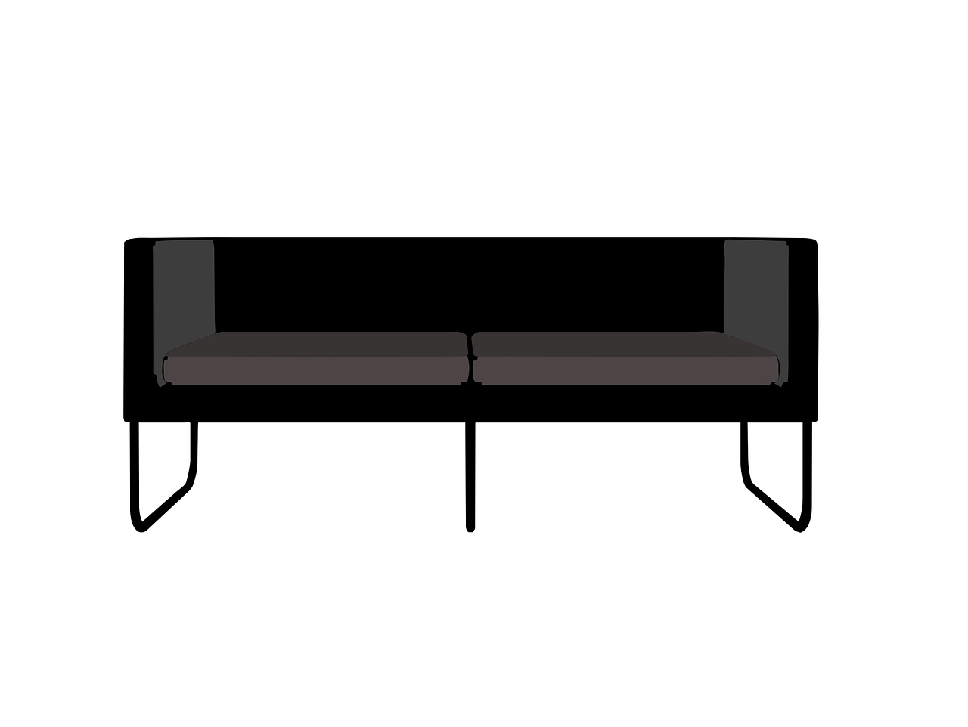
Flexibility in Use
Libraries that have only one style of seating arrangements are not designed for all.
Slide 25

Slide 27
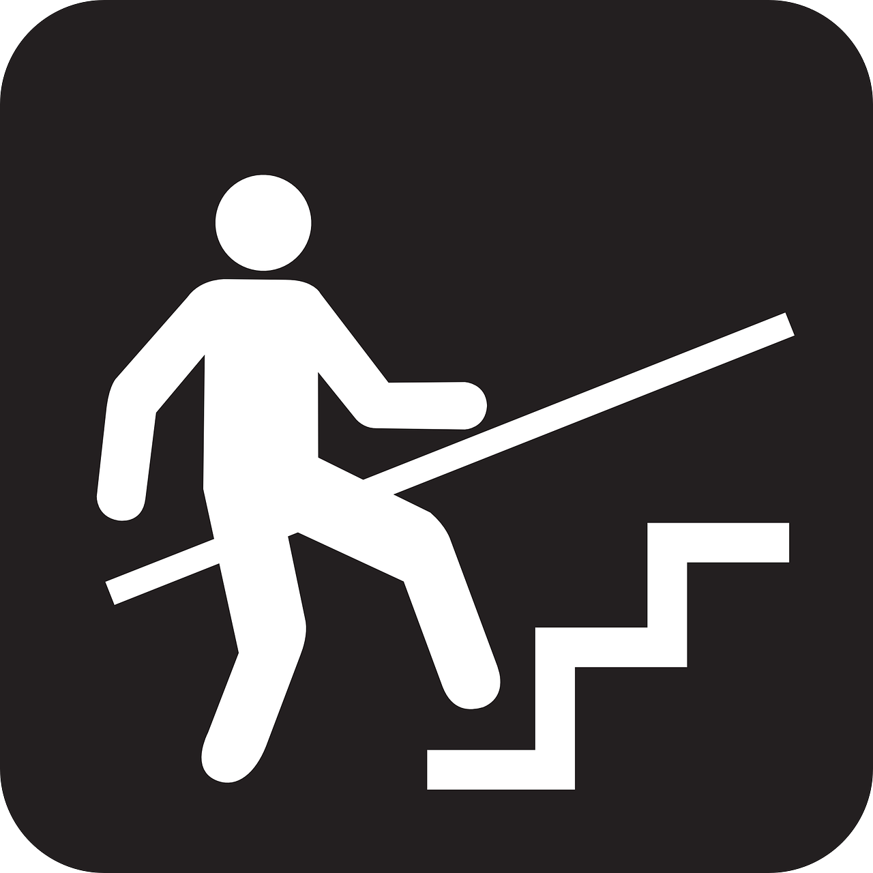
Simple and Intuitive Use
Use signage that has wording, easily recognizable symbols, and braille.
Slide 26

Slide 28
Perceptible Information
At the entrances to the library have a space that communicates the library layout along with “you are here” locators. This is also helpful to have in the stacks, particularly for libraries that have multiple floors and multiple sections on each floor.
Slide 27

Slide 29
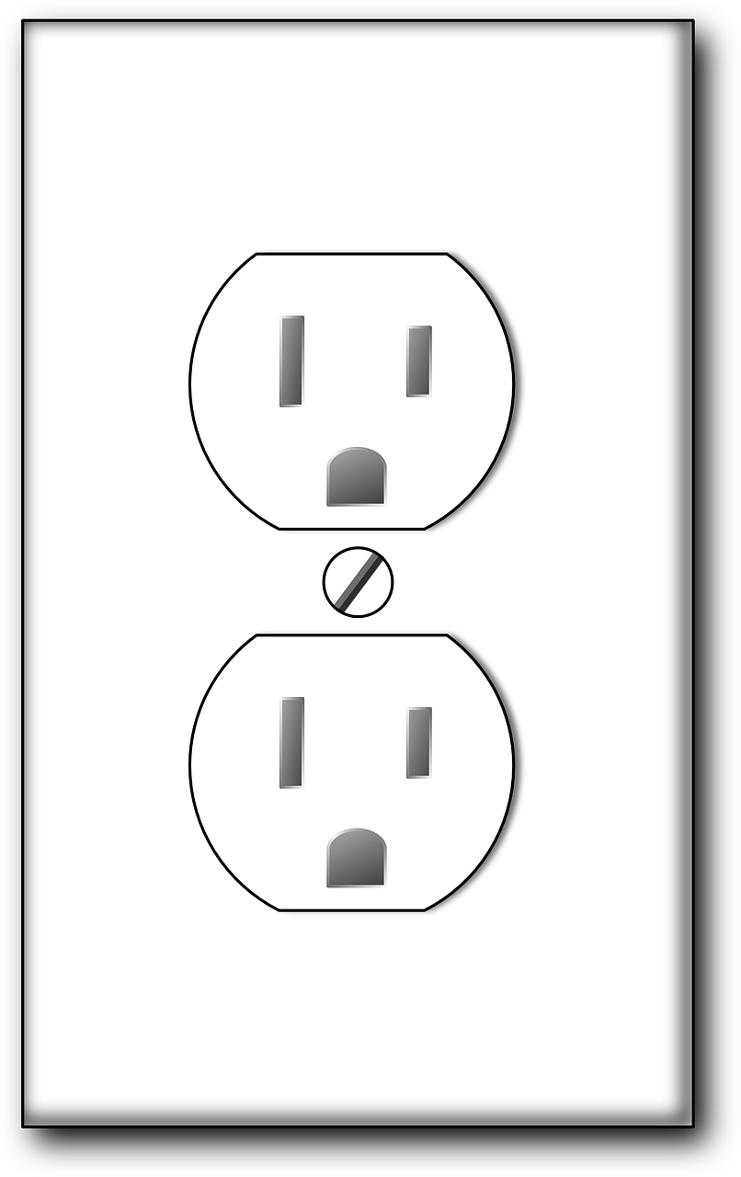
Tolerance for Error
Avoid power outlets that stick up in the middle of the floor and power outlets that are behind the bottom bookshelf. Nowadays, patrons require more access to power outlets and as well as easy and quick access.
Slide 28

Slide 30
Low Physical Effort
Shelving takes up a lot of space and it is hard to navigate around for patrons in a wheelchair. Providing online content such as eBooks and audiobooks allows for more open space at your library.
Slide 29

Slide 31
Size and Space for Approach and Use
Allow for the patron to create their own work space. Desks where the patron can change the hight at will are also good accessible furniture.
Slide 30

Slide 32
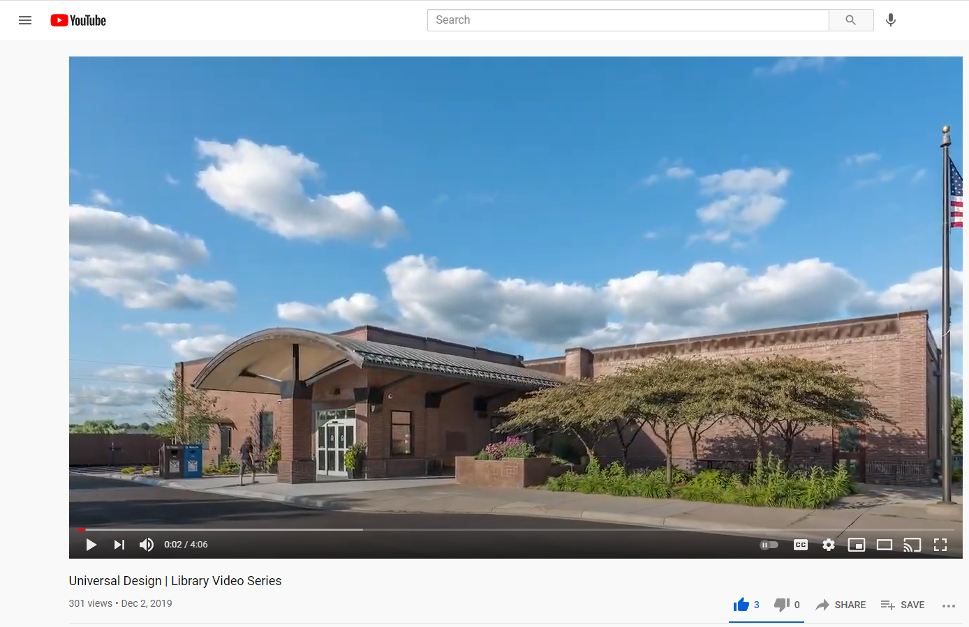
Universal Design Video
Video: “Universal Design - Library Video Series.” (4:06 minutes). -
Link to the Universal Design Video
Slide 31

Slide 33
Discussion (#5)
What are some examples of Universal Design that your library has already implemented?
Is there something you would like to see implemented at your library regarding accessibility (think of an encounter with a patron with a disability, what type of program or service would benefit them)?
Slide 32

Slide 34
The Law and ALA Policy
Slide 33

Slide 35
The Rehabilitation Act of 1973
The Rehabilitation Act of 1973 bans discrimination based on disability in federal programs and institutions that receive federal funding.
Slide 34

Slide 36
Section 508 of The Rehabilitation Act
Equal Access
Includes electronic information
Federal funding (including school libraries and public libraries)
Slide 35

Slide 37
Discussion (#6)
What are some ways that the library provides equal access to information and resources?
Slide 36

Slide 38
Americans with Disabilities Act
Entitled to the same rights as everyone else
Businesses can’t discriminate on hiring based on disability
Title II
Physical Access to buildings
Effective communication
Libraries must include:
Large print and braille books (alternative formats)
Slide 37

Slide 39
ADA Library Examples
Tables at the library should have 27 inch high clearance and 19 inches of depth.
Space between furniture should be 40 inches.
The top row at the stacks shouldn’t be higher than 48 inches.
Aisle should have at least 36 inches of clearance but 42 inches is preferred.
Service desks (reference, check out, etc.) shouldn’t be higher than 36 inches.
The floor should be smooth and bump free.
Slide 38

Slide 40
Discussion (#7)
Brainstorm five more examples of things that you can implement in your library that can be ADA compliant.
Slide 39

Slide 41
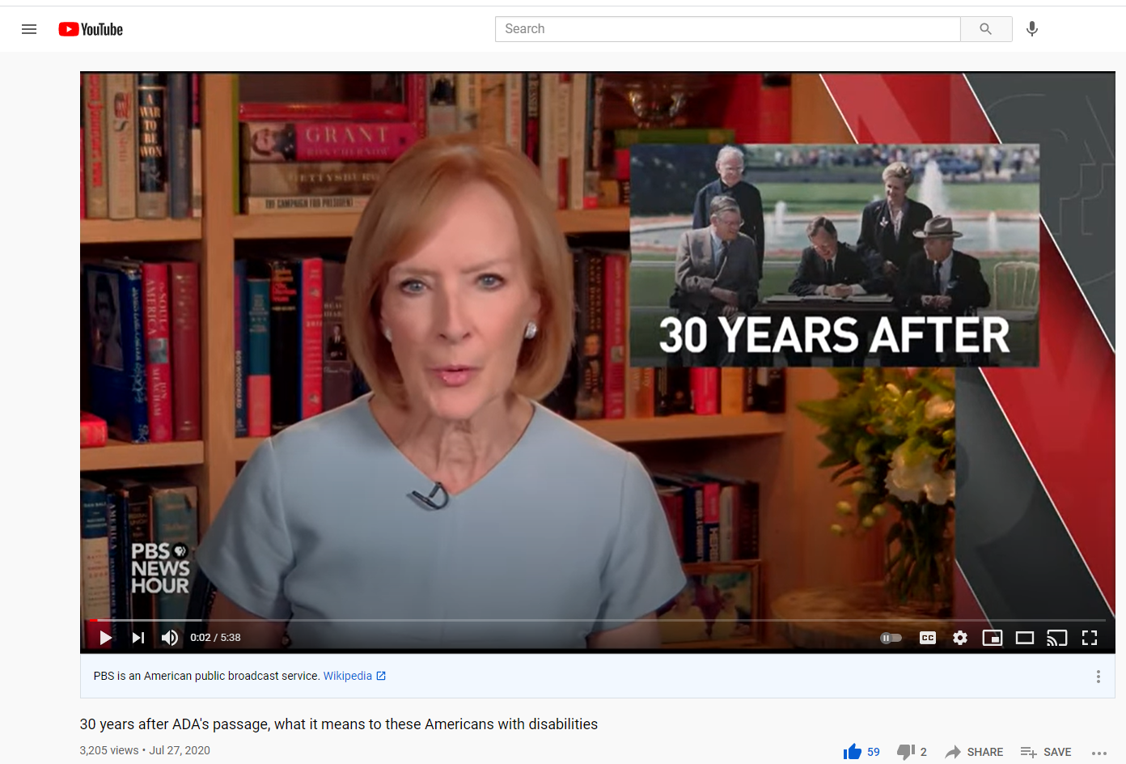
30 Years After ADA Video
Video: “30 years after ADA's passage, what it means to these Americans with disabilities.” (5:38) - Link to the "30 Years After" Video
Slide 40

Slide 42
ALA Policy - Part 1
History of serving people with disabilities
Library of Congress first services to people with disabilities was in 1897
Standards regarding equal access were created in 1961
Policy was updated in 2001
Slide 41

Slide 43
ALA Policy - Part 2
The Scope of Disability Law
Library Services
Facilities
Collections
Assistive Technology
Employment
Library Education, Training, and Professional Development
ALA Conferences
ALA Publications and Communications
Slide 42

Slide 44
Providing equitable access for people with disabilities is required by federal law.
Examples: Section 504 of the Rehabilitation Act of 1973 and The Americans with Disabilities Act of 1990.
The Scope of Disability Law
Slide 43

Slide 45
Libraries must not discriminate against people with disabilities. Libraries should provide accommodations as well as include people with disabilities in planning and evaluation of library spaces.
Examples: Extended loan periods, waived late fines, extended reserve periods, etc.
Library Services
Slide 44

Slide 46
Libraries are required to follow ADA regulations regarding physical space.
Examples: clear paths of travel
to and throughout the facility,
accessible tables, public
service desks, etc.
Facilities
Slide 45

Slide 47
Library materials must be accessible to patrons with disabilities and with a variety of formats.
Examples: Audiobooks, books, graphic novels, large print, movies, etc.
Collections
Slide 46

Slide 48
Libraries should integrate assistive technologies into their libraries based on communications with people with disabilities, agencies, organizations and vendors.
Examples: screen readers, audiobooks, etc.
Assistive Technology
Slide 47

Slide 49
Libraries should recruit people with disabilities into the LIS field and provide accommodations for employment.
Example: Extra time on civil service tests, tests read out loud, etc.
Employment
Slide 48

Slide 50
All graduate programs should teach students about accessibility, assistive technology and the needs of people with disabilities in regards to library services.
Example: Accessibility classes,
professional development
for staff regarding accessibility,
etc.
Library Education, Training, and Professional Development
Slide 49

Slide 51
ALA conferences must be held at locations that are accessible to people with disabilities.
Example: Easy to navigate locations, microphones at lectures, etc.
ALA Conferences
Slide 50

Slide 52
Works published under ALA must be available in alternative formats.
Example: Electronic text, audiobooks, etc.
ALA Publications and Communications
Slide 51

Slide 53
Activity #1
Directions:
Break into small (3-5) discussion groups (group size depends on the amount of people attending).
Three different library scenarios will be shown on the PowerPoint slide.
Each group will be assigned a scenario and decide what you would do in that situation, keeping in mind the Universal Design principles.
After 15 minutes the groups will come back together and a speaker for each group will discuss what the group decided and why.
Slide 52

Slide 54
Scenario 1
You are a reference librarian at a mid-sized public library in a city. A patron comes up to your desk and you notice that they hold a white cane. She tells you that she just moved to the area and that it’s her first time in the library. She also tells you she is looking for a book on how to care for household plants. As the patron is asking their question, two other patrons que up behind her and look impatient. What do you do?
Slide 53

Slide 55
Scenario 2
You are a librarian at a school library working at the check-out desk. Your library doubles as an instruction space. A middle school age kid comes into the library with a guide dog to look for audio books during his study hall. Your colleague is busy teaching a class how to cite different types of resources for the class’s end of the year project. The presence of the dog distracts multiple kids to the point where the class teacher comes to you to ask that the student with the guide dog leave the library. What do you do?
Slide 54

Slide 56
Scenario 3
You are a librarian at an academic library in a private university. Your library has been receiving complaints from the Deaf community on campus about the lack of American Sign Language (ASL) interpreters on library staff. Your boss acknowledges the problem and suggests that the staff covering the reference and circulation desks be trained in ASL. However, there is not enough funds in the budget for training and the budget for the following year has already been sent to the board for approval. What do you do?
Slide 55

Slide 57
Role Play Debriefing
What do you think was the most important outcome of this roleplay?
In your role-play session, what, if anything, should have been asked or included that wasn’t?
What did you learn from this activity?
Slide 56

Slide 58
Break
Slide 57

Slide 59
Applying Universal Design to Libraries
Slide 58

Slide 60
Physical Barriers
Slide 59

Slide 61
“No amount of smiling at a flight of stairs has ever
made it turn into a ramp.”
Quote by Stella Young
Slide 60

Slide 62
Project ENABLE - Challenge Video (#1)
Video: “The Challenge - Holly Jin - Physical Barriers” (3:20) -
Link to Challenge Video
Slide 61

Slide 63
Discussion (#8)
What would you do?
Slide 62

Slide 64
Project ENABLE - Solutions Video (#1)
Video: “The Solution - Holly Jin - Physical Barriers.” (7:24). -
Link to Solutions Video
Slide 63

Slide 65
Examples of Physical Barriers in the Library - Part 1
Building Orientation: Display maps near the entrances of where everything is located.
Service Desks: Service Desks (reference, tech help, check out, etc.) need to be at a height accessible to a person with a wheelchair.
Shelving: Bottom shelves tilted up, avoid placing books on the top row.
Slide 64

Slide 66
Examples of Physical Barriers in the Library - Part 2
Learning and Study Areas: Make sure patrons can choose the layout they want and have flexible furniture available in study areas.
Power outlets: Avoid floor outlets and extension cords.
Lighting: Avoid fluorescent lights as it can give headaches to people who are light sensitive. Use warm light.
Slide 65

Slide 67
Examples of Physical Barriers in the Library - Part 3
Self-service: There are both pros and cons. It is faster and more efficient yet someone who isn’t used to using technology might find it
Navigation: Spaces between shelves should be 36 inches, heights of tables for wheelchair access should be 27 inches height, etc.
Slide 66

Slide 68
Collection Development
Slide 67

Slide 69
Collection Development and UD
Collection Development is an important part of building an Inclusive and accessible library. There are two main ways to go about building an Inclusive collection.
Type of materials
Content of Materials
Slide 68

Slide 70
Some students may benefit from a large collection of interesting periodicals/magazines.
Periodicals/Magazines
Slide 69

Slide 71
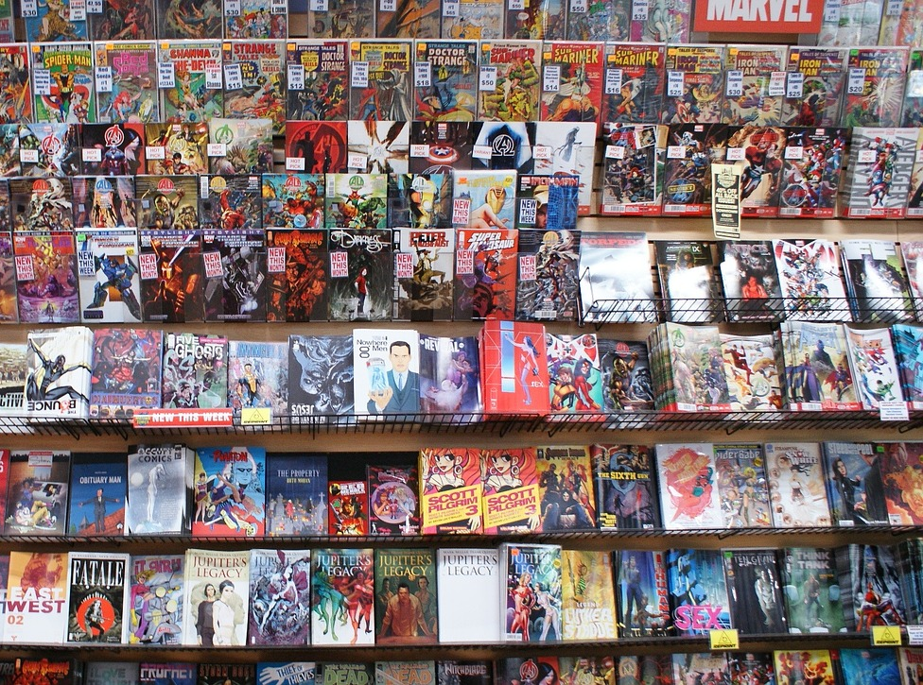
Graphic Novels
While graphic novels have a wide appeal to the entire student body, they may be especially helpful for students with intellectual or learning disabilities who struggle with reading.
Slide 70

Slide 72
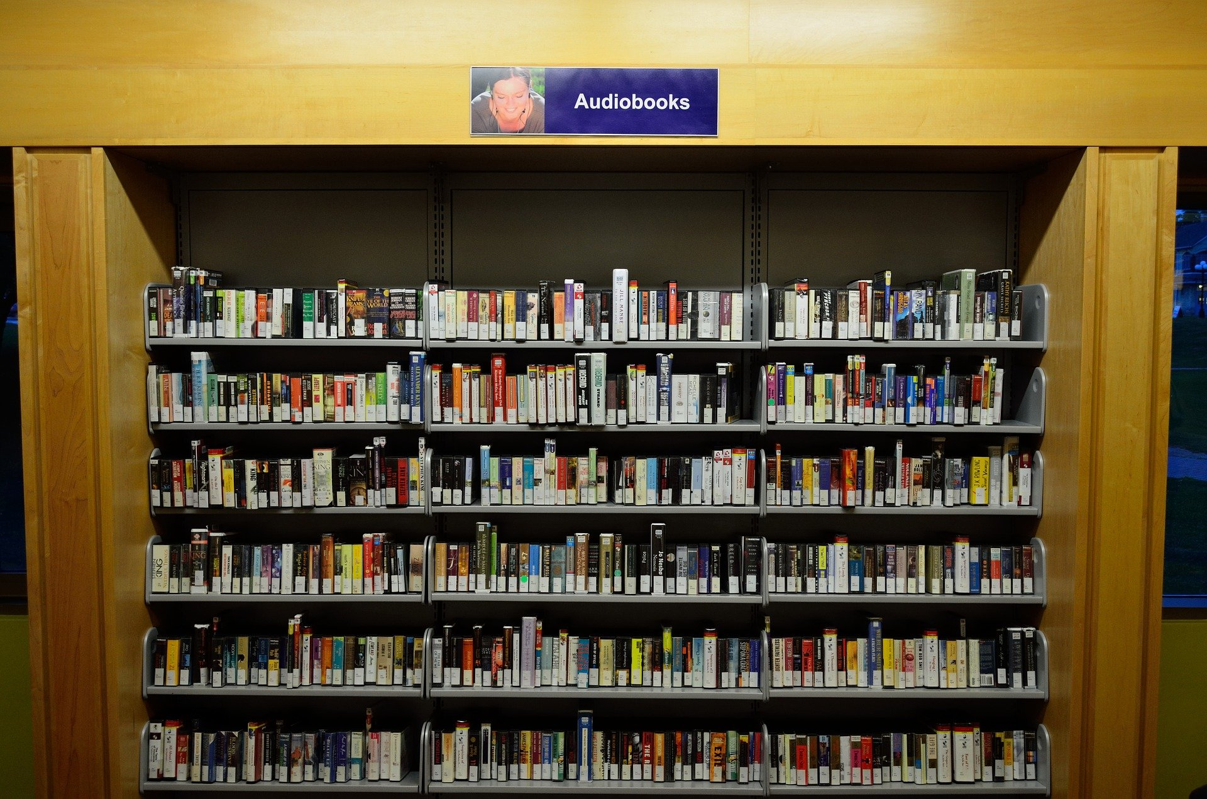
Audiobooks
Audiobooks are available on cassette, CD, playaway, or digital recording.
Slide 71

Slide 73
Large Print Books
Students with visual impairments may be aided by the use of large print books.
Slide 72

Slide 74
iPods & Other MP3 Players
iPods and other MP3 players can be loaded with audiobooks for the enjoyment of all students.
Slide 73

Slide 75
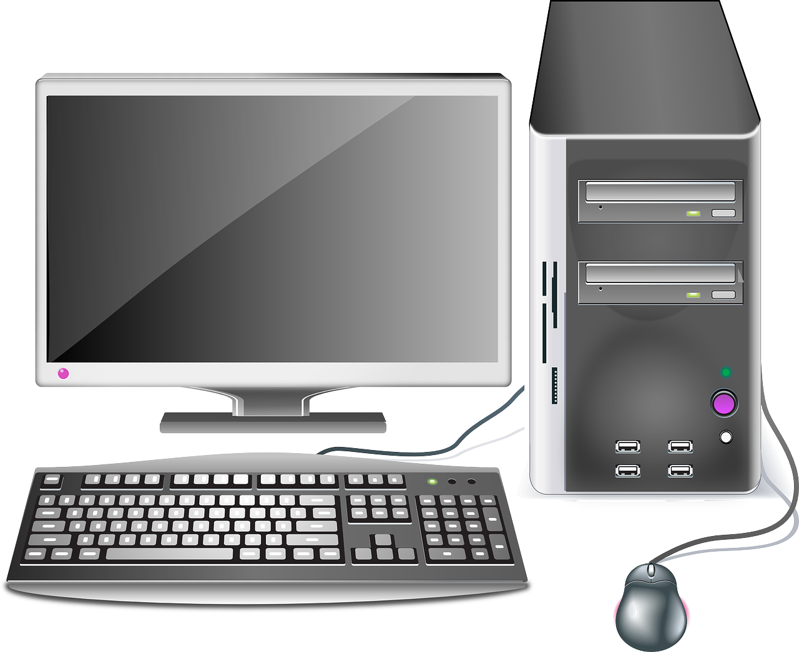
Tablet Computers & eReaders
Tablet, computers, and eReaders assist readers in a variety of ways.
Slide 74

Slide 76
Braille Material
Braille is a tactile writing system used by people with visual impairments.
Most state libraries have talking book collections as well that can be acquired through interlibrary loan.
For example, the National Library Service for the Blind and Print Disabiled is an excellent resource that you can use.
Slide 75

Slide 77
Content of Materials
While having access to different types of resources is good to have, having a book with disability representation is just as important.
Historically, people with disabilities are underrepresented in books.
However, disability representation in books began to turn more positive in the late 1990s and early 2000s.
There are two main types of disability representation in books. They are Inclusion Literature and Immersive Literature
Slide 76

Slide 78
Inclusion Literature
The disability is the focal point of the story.
Inclusion Literature “can help patrons develop awareness and empathy by providing a genuine connection to the lives of individuals with disabilities.”
Slide 77

Slide 79
Immersive Literature
Immersive Literature includes a character with a disability, but that disability is not the story’s focal point. The disability community prefers this type of literature.
However, there are few picture books of this type of literature.
Slide 78

Slide 80
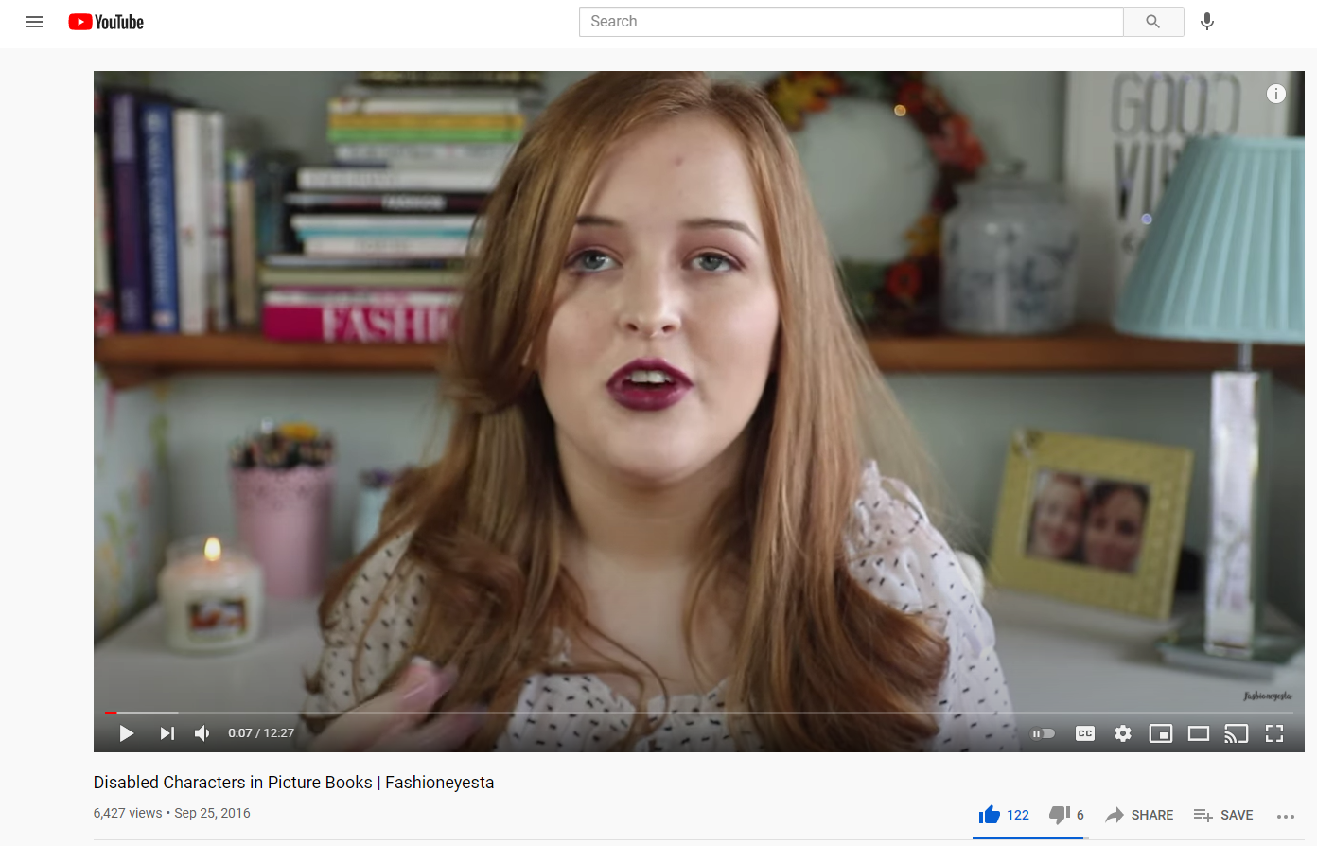
Video: “Disabled Characters in Picture Books.” (12:57) -
Link to Disabled Characters in Picture Books Video
Disabled Characters in Picture Books
Slide 79

Slide 81
Discussion (#9)
Why is it important for children with disabilities to see themselves represented in children's books?
Slide 80

Slide 82
The Schneider and Dolly Gray Awards
Slide 81

Slide 83
Programming
Slide 82

Slide 84
Makerspaces - Part 1
Collaborative spaces in libraries and schools that promote teamwork in creating DIY (“Do It Yourself”) projects
Open to both children and adults
Includes both “High Tech” (ex: 3D printers) and “Low Tech” (ex: Legos)
Slide 83

Slide 85
Makerspaces - Part 2
The Fayetteville Free Library in upstate New York was the first public library in the U.S. to create a makerspace. They called it the “Fab Lab” and contains a variety of tools:
3D printers
Laser Cutters
Vinyl Cutters
CNC Mills
Sewing Machines
Slide 84

Slide 86
Examples of Machines in Makerspaces
Sewing Machines
3D Printers
Laser Cutters
Hand Tools
Electronics
Rapid Prototyping
Computers
Slide 85

Slide 87
Sensory Story Time - Part 1
Geared toward younger children in the 2-5 year old range who have sensory processing difficulties.
Provides less distractions and focus more on situational awareness while accomplishing the main activity.
Slide 86

Slide 88
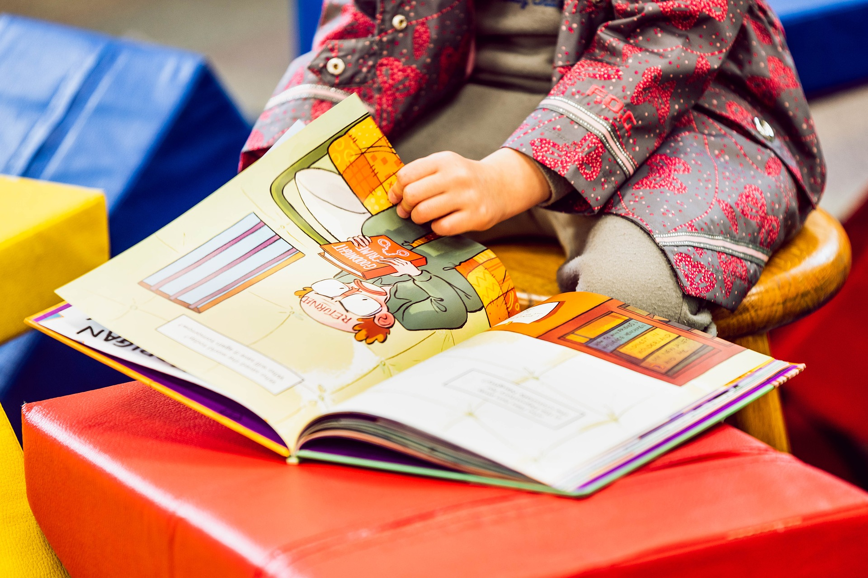
Sensory Story Time - Part 2
Seeing
Hearing
Touching
Smelling
Tasting
Proprioception - Awareness of one’s body.
Vestibular - Understanding ourselves in proportion to the world.
Slide 87

Slide 89
Sensory Story Time - Part 3
Utilizes the combination of the reenactment of colorful picture books, calming music, dancing, and crafts in order to help the children stimulate their senses.
Works on socializing with peers as well as practice making choices in low-stakes settings.
Slide 88

Slide 90
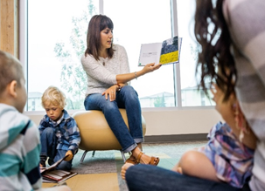
Sensory Story Time Best Practices
Have a visual schedule
Repeat
Its okay to shorten stories
Have designated spots for each child to sit
Keep it small
Turn it down
Make it interactive
Slide 89

Slide 91
Project ENABLE - Challenge Video (#2)
Video: “The Challenge - Rachel Combs - Adequate Program Accessibility” (3:00) - Link to Challenge Video
Slide 80

Slide 92
Discussion (#10)
What would you do?
Slide 91

Slide 93
Project ENABLE - Solutions Video (#2)
Vdeo: “A Solution - Rachel Combs - Adequate Program Accessibility” (5:25) -
Link to Solutions Video
Slide 92

Slide 94
Website Accessibility
Slide 93

Slide 95
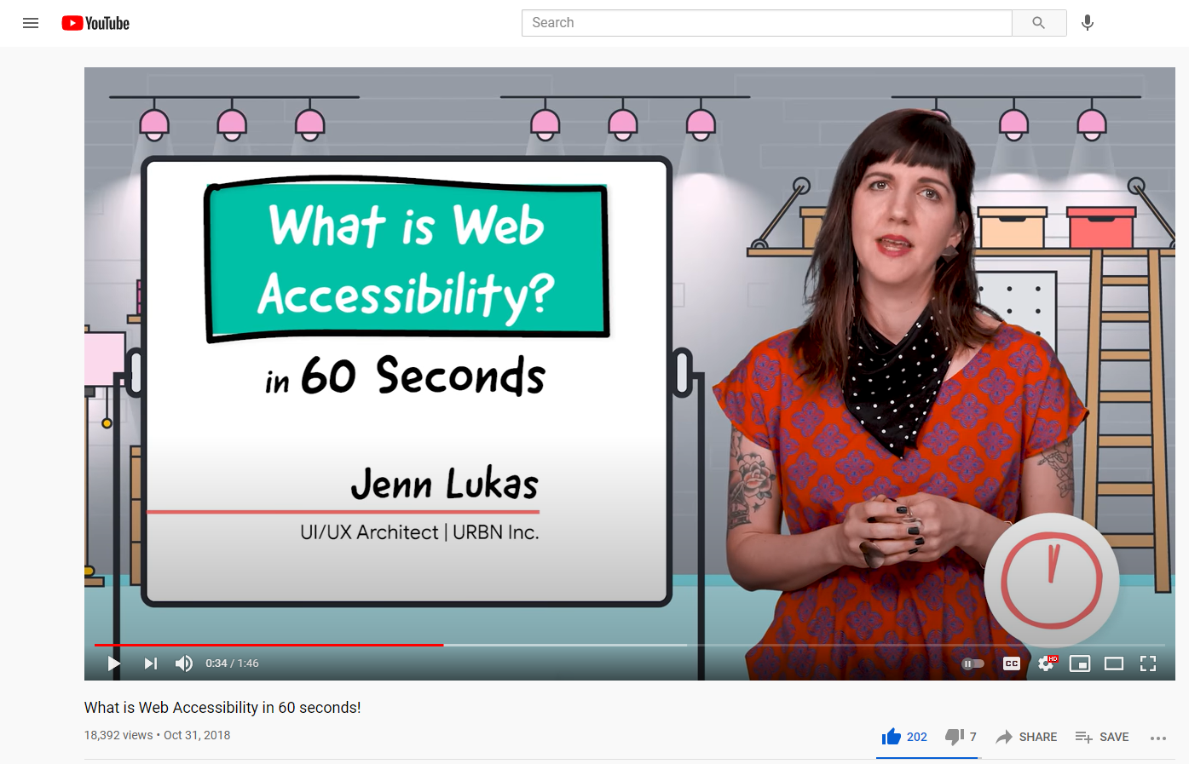
What is Website Accessibility?
Video: “What is Web Accessibility in 60 seconds!” (1:46) -
Link to Website Accessibility Video
Slide 94

Slide 96
UD and the Library Website - Part 1
Equitable Use - Changing the color contrast on your library website to avoid stigmatizing patrons with color blindness.
Flexibility in Use - Providing customization for dashboards can enable patrons to be able to choose for themselves how they want the layout of the website to look like.
Simple and Intuitive Use - Don’t have a busy webpage. This can cause distraction and make navigation through the website tedious. Sometimes, a simple design is the best design.
Slide 95

Slide 97
UD and the Library Website - Part 2
Perceptible Information - Adding transcripts and closed captions to videos on your library website can help patrons who have trouble hearing.
Tolerance for Error: If your library website has a login form, make sure to add input format validation errors. This basically means if you type a password wrong or leave a form blank, the page responds by showing text next to the form indicating what was wrong. If the patron types the wrong letter by accident, it will let the patron know rather than just being blocked.
Slide 96

Slide 98
UD and the Library Website - Part 3
Low Physical Effort: Make sure that your library website is navigable by the tab feature on keyboards. Using the tab key as a way to navigate through the website can help patrons who have trouble clicking a mouse.
Size and Space for Approach and Use: Use the text to describe where the link will go. For example, the text “Click Here” is not a helpful link name but “About Us” is. This helps the user navigate the website easier.
Slide 97

Slide 99
WCAG Guidelines
You can also use the Web Content Accessibility Guidelines 2.1 (WCAG 2.1) as another tool in assessing your library's website.
These were created by the World Wide Web Consortium, otherwise known as W3C.
The first guidelines, WCAG 1.0, were published in 1999. The current version is WCAG 2.1 (as of June 2021), which was released in 2018.
W3C is currently in the process of creating the WCAG 2.2 standards that you can see if you visit their website.
Slide 98

Slide 100
Web Content Accessibility Guidelines 2.1 (WCAG 2.1) - Part 1
Perceivable - Information and user interface components must be presentable to users in ways they can perceive;
Provide text alternatives for any non-text content so that it can be changed into other forms people need, such as large print, braille, speech, symbols or simpler language.
Provide alternatives for time-based media.
Create content that can be presented in different ways (for example simpler layout) without losing information or structure.
Make it easier for users to see and hear content including separating foreground from background.
Slide 99

Slide 101
WCAG 2.1 - Part 2
Operable - User interface components and navigation must be operable;
Make all functionality available from a keyboard.
Provide users enough time to read and use the content.
Do not design content in a way that is known to cause seizures or physical reactions.
Provide ways to help users navigate, find content, and determine where they are.
Make it easier for users to operate functionality through various inputs beyond the keyboard.
Slide 100

Slide 102
WCAG 2.1 - Part 3
Understandable - Information and the operation of user interface must be understandable;
Make text content readable and understandable.
Make Web pages appear and operate in predictable ways.
Help users avoid and correct mistakes.
Slide 101

Slide 103
WCAG 2.1 - Part 4
Robust - Content must be robust enough that it can be interpreted by a wide variety of user agents, including assistive technologies.
Maximize compatibility with current and future user agents, including assistive technologies.
Slide 102

Slide 104
Discussion (#11)
Can you think of other website accessibility examples?
Slide 103

Slide 105
Web Accessibility Tools
Google Lighthouse - A Chrome browser extension. It provides you with an immediate report on the accessibility of your website. Google Lighthouse looks at the performance, accessibility, best practices, and SEO of the webpage. Free to use.
WAVE - A browser extension that provides you with visual feedback on your webpage by using different color icons. Each icon indicates a different error. Free to use.
Slide 104

Slide 106
Activity #2
Directions:
Break into small (3-5) discussion groups (group size depends on the amount of people attending).
Begin an action plan of how to get started on applying universal design in your library.
Put at least two examples for each category (physical barriers, website accessibility, collection development, program development, and policy).
After 15 minutes the groups will come back together and a speaker for each group will discuss what the group decided and why.
Slide 105

Slide 107
Recap
Models of Disability
Design Theories
Universal Design Principles
The Law and ALA Policies
Physical Barriers
Collection Development
Programming
Website Accessibility
Slide 106

Slide 108
Closing
Complete the workshop evaluation.
Submit it to the instructor.
Take what you have learned and apply at least one new idea to your library.
Enjoy your day!
Slide 107

Slide 109
Thank you!
Slide 108

