Slide 1
Workshop 1:
Accessibility and Inclusion for Patrons with Disabilities: The Basics

Slide 2
Welcome!
Slide 1

Slide 3
Introductions
Slide 2

Slide 4
Learning Objectives
Understand the importance of treating others with respect and dignity.
Develop a basic understanding of Universal Design and Universal Design for Learning.
Apply what you have learned to programs at your library.
Identify barriers to library access and provide solutions to your library.
Slide 3

Slide 5
Agenda
Foundations
Disability Awareness
Libraries and Patrons with Disabilities
The Law
Activity #1
Slide 4

Slide 6
Agenda - Continued
Applying Library Accessibility
Universal Design
Universal Design for Learning
Activity #2
Recap
Closing
Slide 5

Slide 7
FOUNDATIONS
Slide 6

Slide 8
Disability Awareness
Slide 7

Slide 9
Disability Sensitivity
Video: “Disability Sensitivity Training Video.” (3:40)
Link to Disability Sensitivity Video
Slide 8

Slide 10
Different Types of Disability - Part 1
Physical Disability - Affects a person's mobility.
Sensory Disability - Affects a person’s ability to sense the world around them.
Visual Disability - Affects a person’s ability to see.
Hearing Disability - Affects a person’s ability to hear.
Slide 9

Slide 11
Different Types of Disability - Part 2
Olfactory and Gustatory Disability - Affects a person's ability to taste and smell.
Somatosensory Impairment - Affects a person’s physical sensations, such as touch.
Intellectual Disability - Affects a person’s ability to comprehend and process information.
Mental Health and Emotional Disabilities - Common types are anxiety, mood, obsession, addiction, personality disorders, and PTSD.
Slide 10

Slide 12
Person-First vs Disability-First Language
Person-First: Language that puts the person first before their disability. This is the most common way to address a person with disabilities.
Disability-First: Language that puts the disability first. It centers around the person’s disability but still recognizes that they are a human being.
Slide 11

Slide 13
Medical Model of Disability
The Medical Model defines disability as a medical issue that there is something wrong with the individual, and they need to be cured.
This model says that having a disability is negative and abnormal and that the person shouldn’t be surprised when they are not accepted into “normal” society because of their disability.
Attitudes and biases can also be a barrier for people with a disability.
Slide 12

Slide 14
The Social Model of Disability
The Social Model states that disability is a status put onto people by an unaccommodating society.
It looks to remove the barriers preventing people with disabilities from contributing to society.
The model focuses on helping to change people’s ingrained attitudes towards people with disabilities rather than socially excluding them.
Slide 13

Slide 15
False Assumptions: Non-Library Example
Slide 14

Slide 16
Discussion (#1)
What are your thoughts about this example?
Slide 15

Slide 17
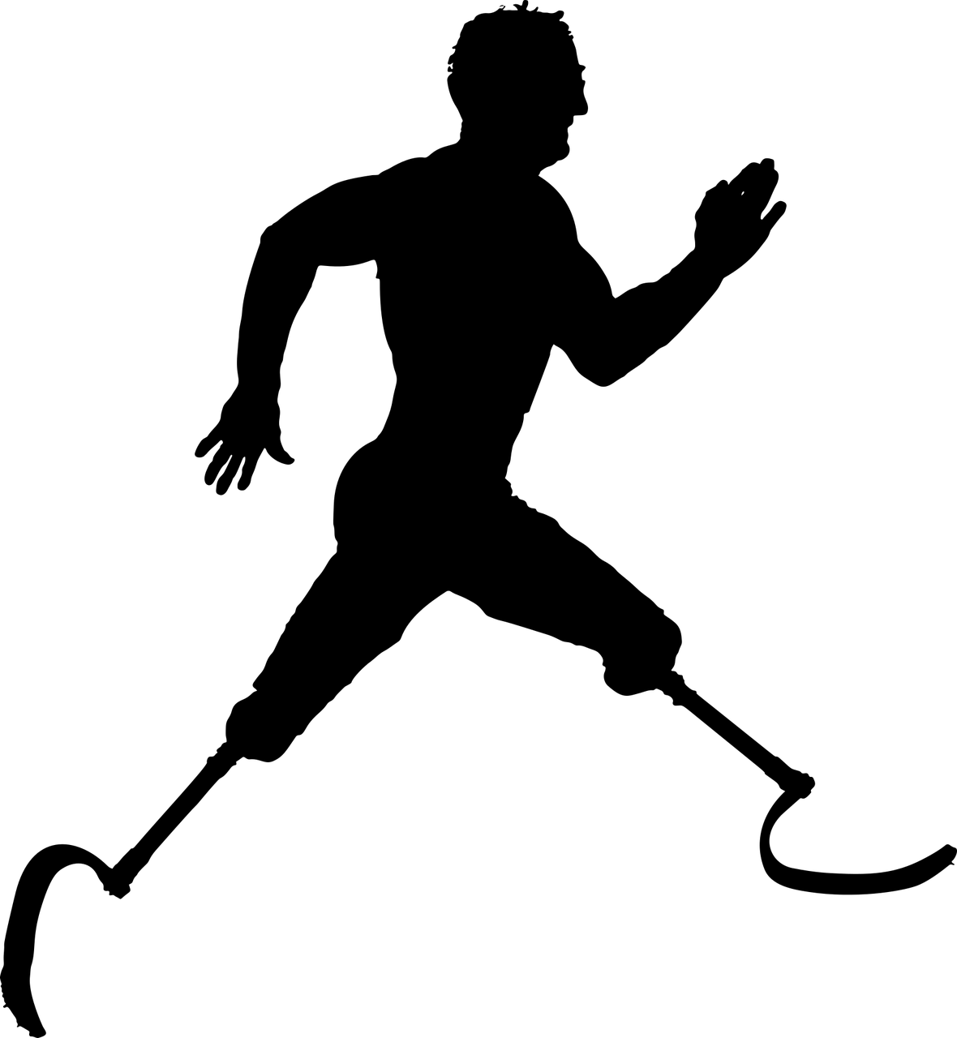
Visible Disabilities
Outwardly demonstrates that a person has a temporary or permanent disability. It is observable by others.
Slide 16

Slide 18
Discussion (#2)
What are some other possible examples of “visible” disabilities?
Slide 17

Slide 19
Invisible Disability
An invisible disability is a temporary or permanent disability that is not outwardly observable. A few examples of “invisible” disabilities are partial blindness or loss of vision, dyslexia, and brain injury.
Slide 18

Slide 20
Discussion (#3)
What are some other examples of invisible disabilities?
Slide 19

Slide 21
False Assumptions - Library Example
Slide 20

Slide 22
False Assumptions & The Library - Part 1
False assumptions about patrons with disabilities can affect how librarians plan their programs and services and the patrons’ ongoing library use and engagement.
Asking individual patrons if they have a disability is an invasion of their privacy. There are ways in which to identify specific programs, services, and resources that may be needed or desired by members of the disabilities community.
Almost ½ of all seniors in the U.S. frequent their library and about 16% of them have at least one disability and half of those have more than one.
False assumptions about patrons with disabilities can affect how librarians plan their programs and services and the patrons’ ongoing library use and engagement.
Slide 21

Slide 23
Discussion (#4)
What might be some reasons for that?
Slide 22

Slide 24
False Assumptions & The Library - Part 2
Sometimes we assume that all people with disabilities need help with every task when some may not need help with any task or may only need help with certain tasks.
That is why, for example, people with autism are considered on a “spectrum.” A common remark about people with autism is, “Once you meet a person with autism, you have met a person with autism.”
Slide 23

Slide 25
Libraries and Patrons with Disabilities
Slide 24

Slide 26
“There is a 100% chance that you will be serving a patron with a disability in your library.”
Dr. Beth Patin, MLIS Professor at Syracuse University
Slide 25

Slide 27
Discussion (#5)
Do you think she’s right?
Slide 26

Slide 28
“I don’t need to design special programs or services for patrons with disabilities because there are no patrons with disabilities in my library.”
Anonymous Librarian
Slide 27

Slide 29
Discussion (#6)
Do you think she’s right?
Slide 28

Slide 30
Some Statistics
“26% of adults in the United States have a disability.” - CDC
Think about how many people 26% of your library’s community represents. That would mean that libraries would be ignoring millions of their community members if they fail to provide appropriate physical spaces and signage, inclusive services and programs, and accessible technologies and resources for all patrons, including those with disabilities.
Slide 29

Slide 31
Some Questions
How can you tell if you have people with disabilities in your library?
You can’t ask a person if they have a disability but what could you do (survey your library constituents, giving them the ability to respond anonymously).
Is it always important to know about every person with a disability in your library?
When might it not be necessary to know this?
There certainly are some visible disabilities that help us identify potential needs, but it is still possible to make false assumptions that lead us in the wrong direction.
Slide 30

Slide 32
Librarian Service to Patrons with
Disabilities
Librarians have a history of campaigning for information access in accessible formats for people with disabilities.
The Library of Congress first began services for people with disabilities in 1897, well before laws such as The Rehabilitation Act of 1973 and The Americans with Disabilities Act of 1990.
ALA created the first set of library standards regarding equal access for people with disabilities in 1961. The current disability policy was approved in 2001.
Slide 31

Slide 33
ALA Policy - Part 1
The Scope of Disability Law: Providing equitable access for people with disabilities is required by federal law.
Library Services: Libraries must not discriminate against people with disabilities. Libraries should provide accommodations and include people with disabilities in the planning and evaluation of library spaces.
Facilities: Libraries are required to follow ADA regulations regarding physical space.
Collections: Library materials must be accessible to patrons with disabilities and various formats.
Assistive Technology: Libraries should integrate assistive technologies into their libraries based on communications with people with disabilities, agencies, organizations, and vendors.
Slide 32

Slide 34
ALA Policy - Part 2
Employment: Libraries should recruit people with disabilities into the LIS (Library and Information Science) field and provide accessible job postings and applications.
Library Education, Training, and Professional Development: All graduate programs should teach patrons about accessibility, assistive technology, and the needs of people with disabilities regarding library services.
ALA Conferences: ALA conferences must be held at locations that are accessible to people with disabilities.
ALA Publications and Communications: Works published under ALA must be available in alternative formats.
Slide 33

Slide 35
The Law
Slide 34

Slide 36
The Rehabilitation Act of 1973
The Rehabilitation Act of 1973 bans discrimination based on disability in federal programs and institutions that receive federal funding.
Slide 35

Slide 37
Section 508 of The Rehabilitation Act
Equal Access
Includes electronic information
Federal funding (including school libraries and public libraries)
Slide 36

Slide 38
Americans with Disabilities Act
Entitled to the same rights as everyone else
Businesses can’t discriminate on hiring based on disability
Title II
Physical Access to buildings
Effective communication
Libraries must include:
Large print and braille books (alternative formats)
Slide 37

Slide 39
ADA Library Examples
Tables at the library should have 27 inch high clearance and 19 inches of depth.
Space between furniture should be 40 inches.
The top row at the stacks shouldn’t be higher than 48 inches.
Aisle should have at least 36 inches of clearance but 42 inches is preferred.
Service desks (reference, check out, etc.) shouldn’t be higher than 36 inches.
The floor should be smooth and bump free.
Slide 38

Slide 40
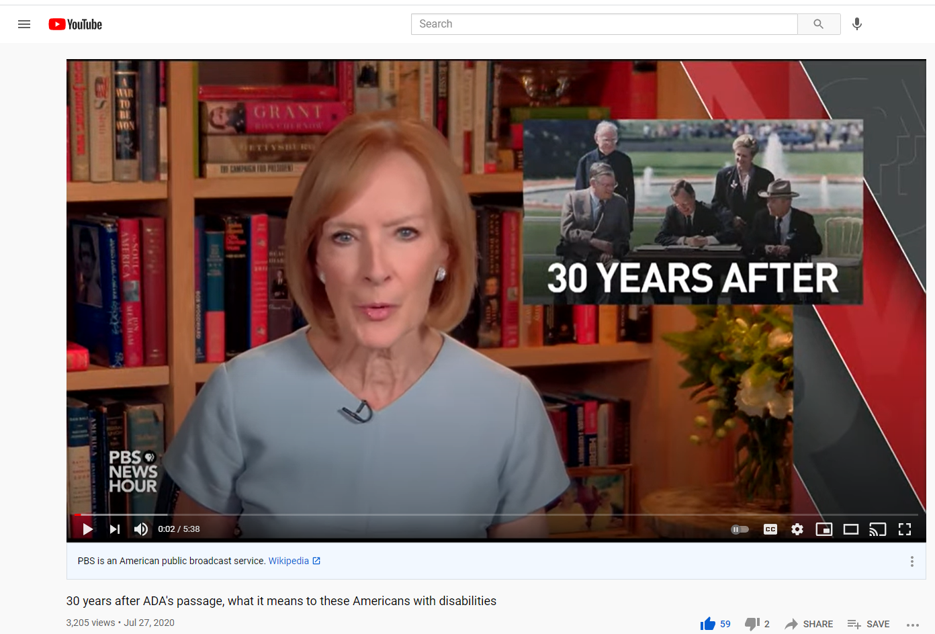
30 Years After ADA Video
Video: “30 years after ADA's passage, what it means to these Americans with disabilities.” (5:38) - Link to the "30 Years After" Video
Slide 39

Slide 41
Activity #1
Break into small (3-5 people) discussion groups (group size depends on the number of people attending).
Five questions will be shown on the PowerPoint slide and on Activity Worksheet #1.
Choose one group member to be the recorder. At the end of this activity, that person will present your ideas to the larger group.
Regroup after 15-20 minutes the groups will come back together, and a speaker for each group will discuss what the group decided and why.
Slide 40

Slide 42
Break
Slide 41

Slide 43
APPLYING LIBRARY ACCESSIBILITY
Slide 42

Slide 44
Universal Design
Slide 43

Slide 45
Project ENABLE - Challenge Video
Video: The Challenge: Charlotte Moman - Lack of Training (3:49)
Link to Challenge Video
Slide 44

Slide 46
Discussion (#7)
What would you do to solve this problem?
Slide 45

Slide 47
Project ENABLE - Solutions Video
Video: A Solution: Charlotte Moman - Lack of Training (8:36)
Link to Solutions Video
Slide 46

Slide 48
Universal Design
Universal Design takes the best concepts from Barrier-Free Design and Accessible Design and combines them.
Universal Design refers to creating products and facilities usable by a wide range of people with varying ability levels.
It is intended to benefit all users by making interaction and use comfortable, safe, and accessible.
Slide 47

Slide 49
Universal Design Examples
Some examples are:
Lighting should be warm; don’t use fluorescents
Use colors that can be identified by people with all types of color vision
Present information in different forms (text, audio, visual, etc.)
Slide 48

Slide 50
7 Principles of Universal Design
Equitable Use - The design is useful and marketable to people with diverse abilities.
Flexibility in Use - The design accommodates a wide range of individual preferences and abilities.
Simple and Intuitive Use - Use of the design is easy to understand, regardless of the user's experience, knowledge, language skills, or current concentration level.
Slide 49

Slide 51
7 Principles of UD - Continued
Perceptible Information - The design communicates necessary information effectively to the user, regardless of ambient conditions or the user's sensory abilities.
Tolerance for Error - The design minimizes hazards and the adverse consequences of accidental or unintended actions.
Low Physical Effort - The design can be used efficiently and comfortably with a minimum of fatigue.
Size and Space for Approach and Use - Appropriate size and space is provided for approach, reach, manipulation, and use regardless of user's body size, posture, or mobility.
Slide 50

Slide 52
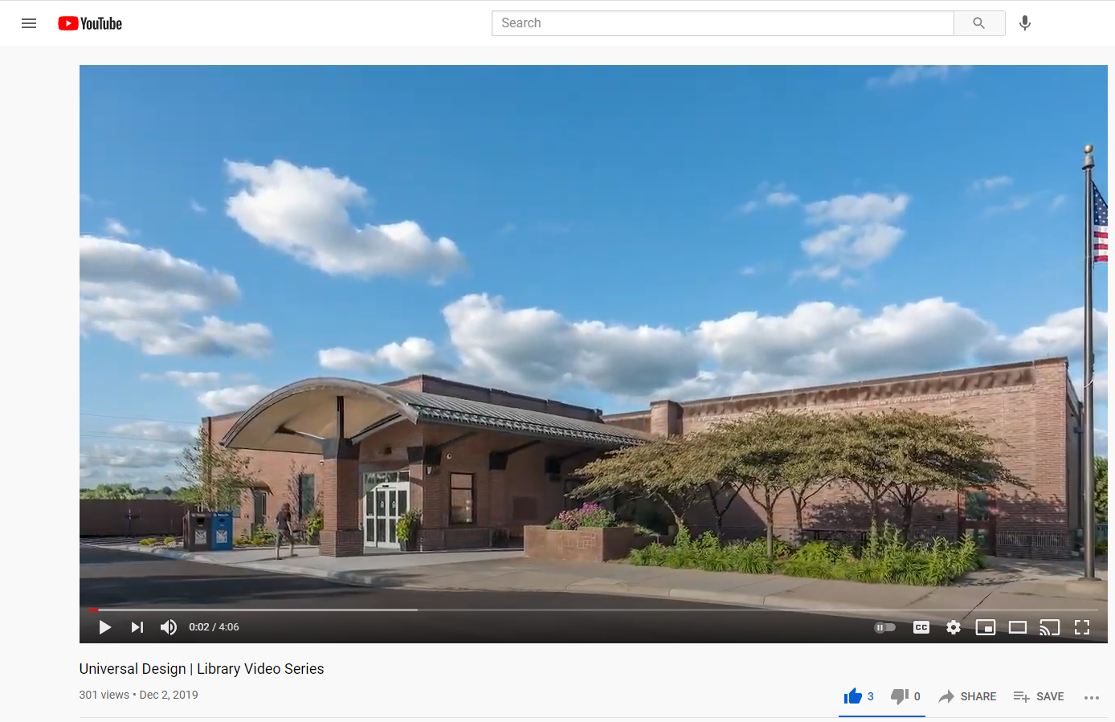
Universal Design Video
Video: “Universal Design - Library Video Series.” (4:06 minutes). -
Link to the Universal Design Video
Slide 51

Slide 53
Universal Design for Learning
Slide 52

Slide 54
Center for Applied Special Technology (CAST)
Engagement - Offer patrons different ways to interact with your content that interests and engage them.
Representation - Present your information in different ways throughout the library program. Don’t just choose one method. Variety adds to interest and engagement, particularly the use of interactive methods of presenting the information.
Action and Expression - Provide different ways to allow the patrons to demonstrate what they’ve learned.
Slide 53

Slide 55
Engagement
Roleplay
Activities
Group discussions
Slide 54

Slide 56
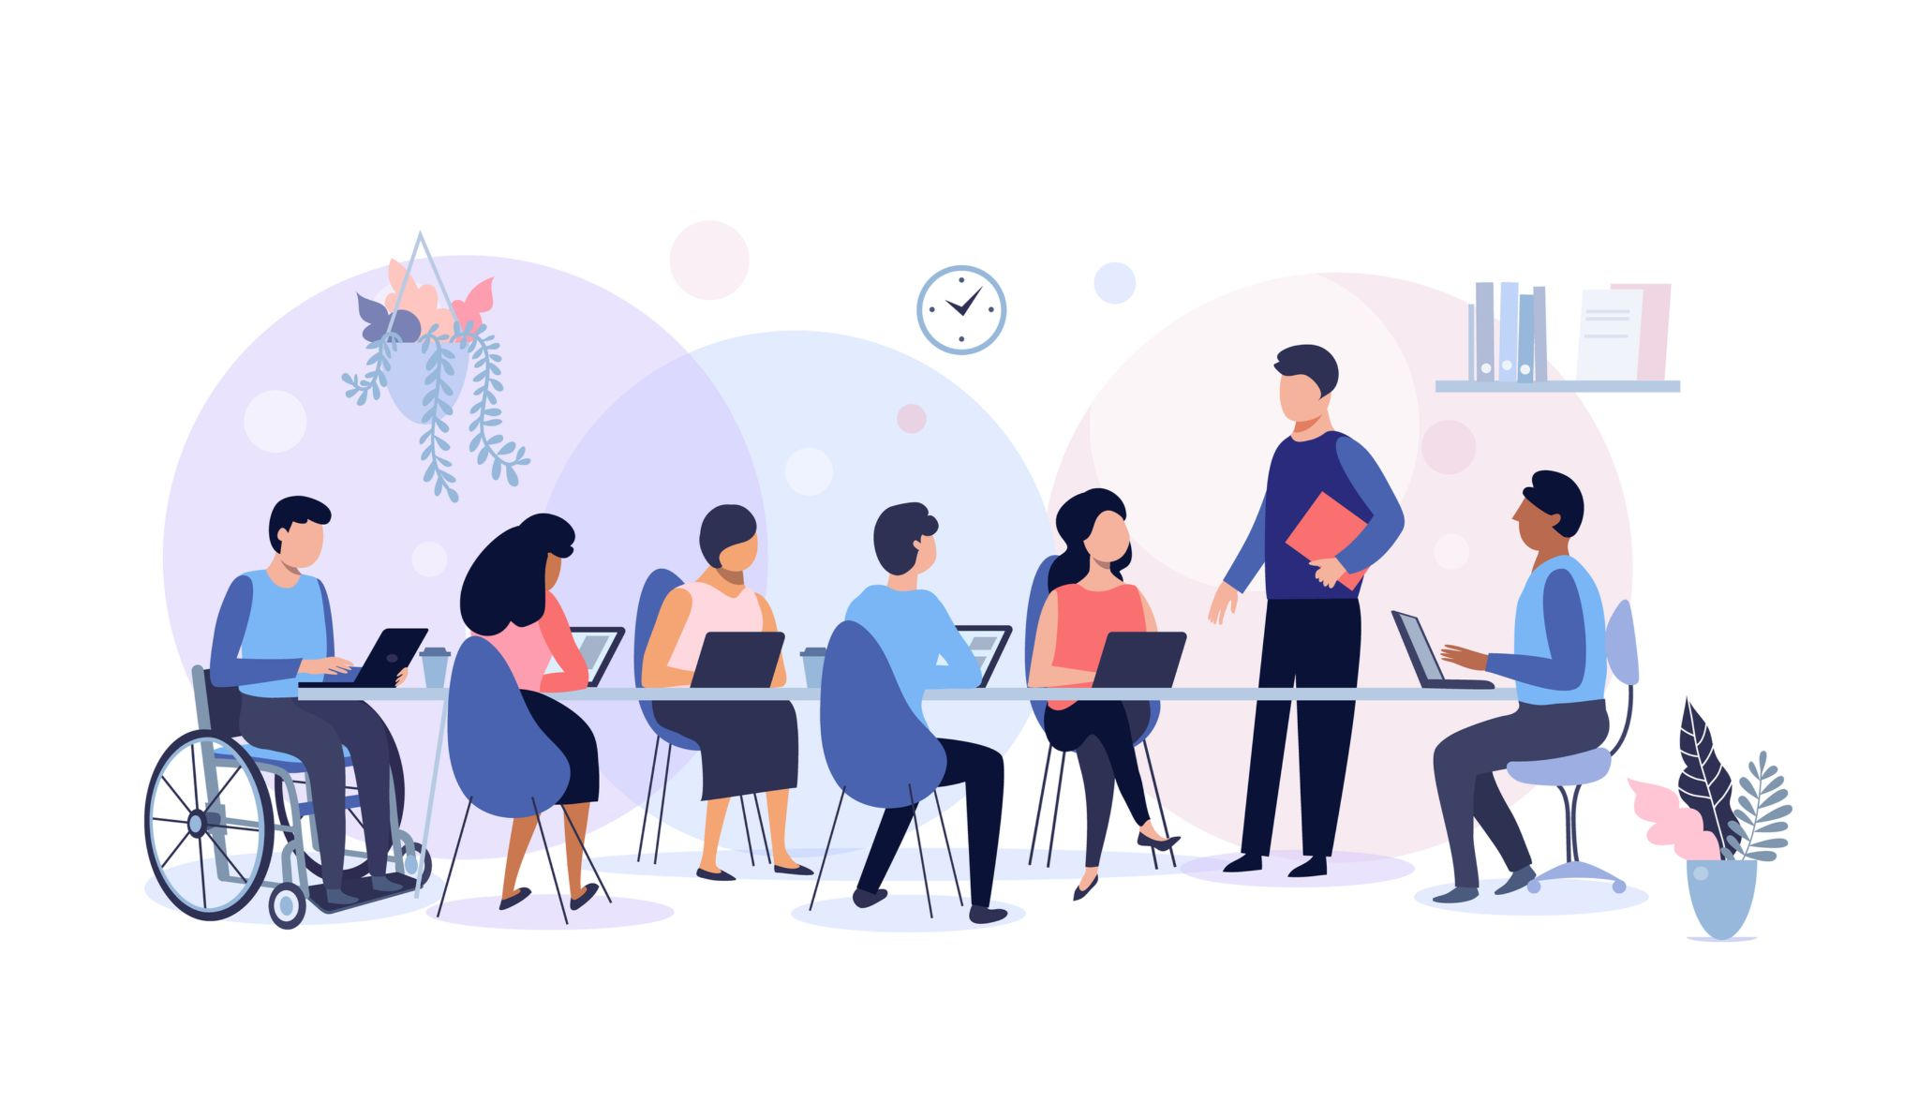
Representation
Lectures
Discussions
Videos
Debates
Computer-based presentations
Slide 55

Slide 57
Action and Expression
Written evidence of learning
Questioning (encourage patrons to ask questions)
Media-based or technology-based evidence of learning (vidoes, interactive learning games like Kahoot)
Slide 56

Slide 58
Diving Deeper into UDL Principles
Each of the UDL principles is further specified by a number of guidelines, with checkpoints that expand upon the guidelines.
Provide options for perception:
Provide captions or transcript for a video.
Present text in larger font sizes.
Provide tactile alternatives for visual displays.
Slide 57

Slide 59
Discussion (#8)
Can you name some ways in which your library implements one or more UDL principles?
Slide 58

Slide 60
Library UDL Examples
Providing e-books in multiple formats.
Providing instructional materials in large, legible fonts.
Finding alternative materials for students with disabilities before beginning instruction or a library program.
Using different media and visual representations to explain a concept, including videos and infographics.
Downloading apps designed for students with disabilities.
Slide 59

Slide 61
Activity #2
Break into small (3-5 people) discussion groups (group size depends on the number of people attending).
You were asked to complete a disabilities audit of your library or section of the library in which you work, using the IFLA checklist. Each person in the group should identify the barriers to accessibility and inclusion for people with disabilities in each of your libraries.
Each person should choose one barrier he/she would like to tackle and discuss in the small group how you might address it when you go back to your library.
Regroup after 15-20 minutes the groups will come back together, and a speaker for each group will discuss what occurred.
Slide 60

Slide 62
Recap
There are different types of disability and some examples of each.
It is important to ask someone if they prefer Person-First or Disability-First language.
The Medical Model faults the person with the disability, The Social Model faults society for not being accessible.
There are two overarching types of disabilities (visible and invisible).
Don’t assume that everyone with the same disability has the same needs.
Universal Design is a space (physical or digital) that all can easily access.
Federal law and ALA policy prohibits discrimination against people with disabilities and require agencies to apply ADA standards.
Universal Design for Learning is an inclusive instructional method of teaching based on Universal Design. Although UDL is a method directed at teachers, librarians can benefit from applying this model to their instruction/programs.
Slide 61

Slide 63
Closing
Complete the workshop evaluation.
Submit it to the instructor.
Take what you have learned and apply at least one new idea to your library.
Enjoy your day!
Slide 62

Slide 64
Thank you!
Slide 63

